Slide 1
BOILERS
ASHI Boiler Presentation 2018

Slide 2
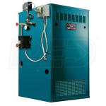
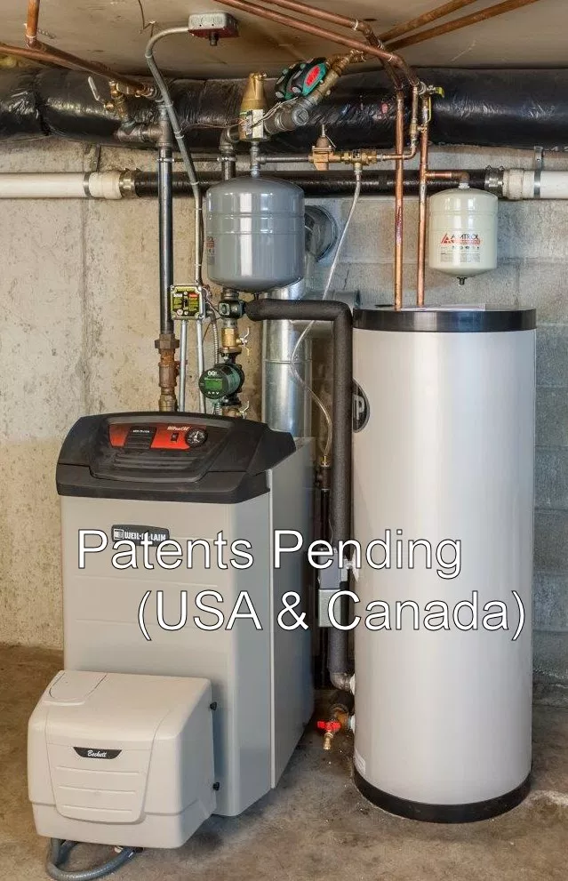
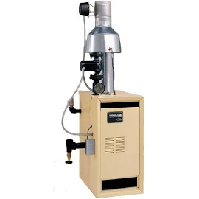
Types Of Boilers
Cast Iron
Steam
Modulating/High Efficiency

Slide 3
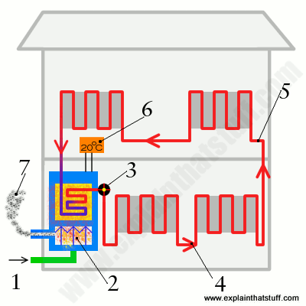
Boiler Basics

Slide 4
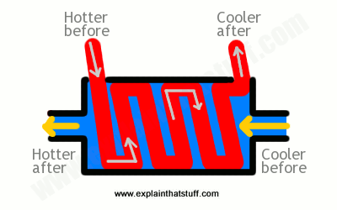
Heat Exchanger
Cast Iron
Tube
Expansion &
Contraction

Slide 5
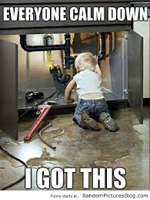
Things To Determine
Water Or Steam
Water Has Pump
Steam No Pump & Site Glass
The main difference between a steam boiler and a hot water boiler is the amount of energy each uses. A steam boiler must burn more fuel (gas or oil) to raise the temperature of its water to boiling level, and this makes hot water boilers more energy efficient, using approximately 25% less energy than steam boilers.

Slide 6
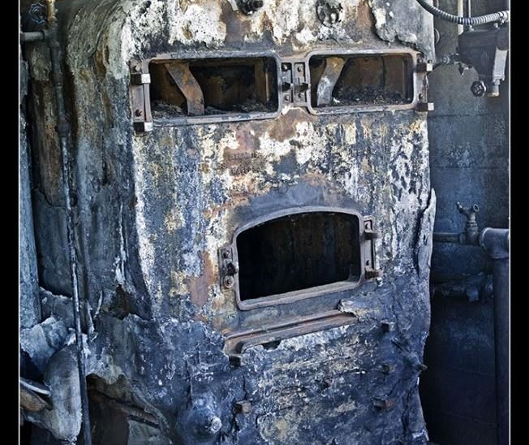
Components
Burner – the burner is the area where the air mixes with your fuel source and combusts.
Combustion chamber/firebox – this is the chamber where the combustion from the burner heats the heat exchanger; this chamber can reach temperatures of several hundred degrees.
Heat exchanger – the heat exchanger allows the heat from the combustion chamber to heat the water in the boiler’s tank.
Aquastats – these components sense the temperature of the water in your boiler and tell the burner when to start and stop.
Expansion tank – the expansion tank is a small tank off the main boiler that helps protect your system from excessive pressure

Slide 7
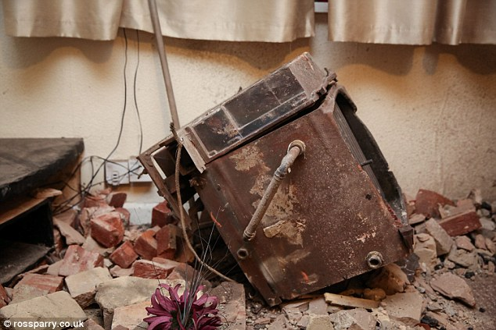
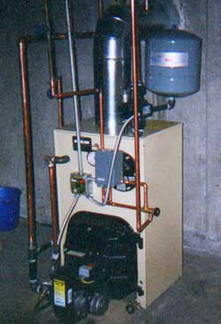
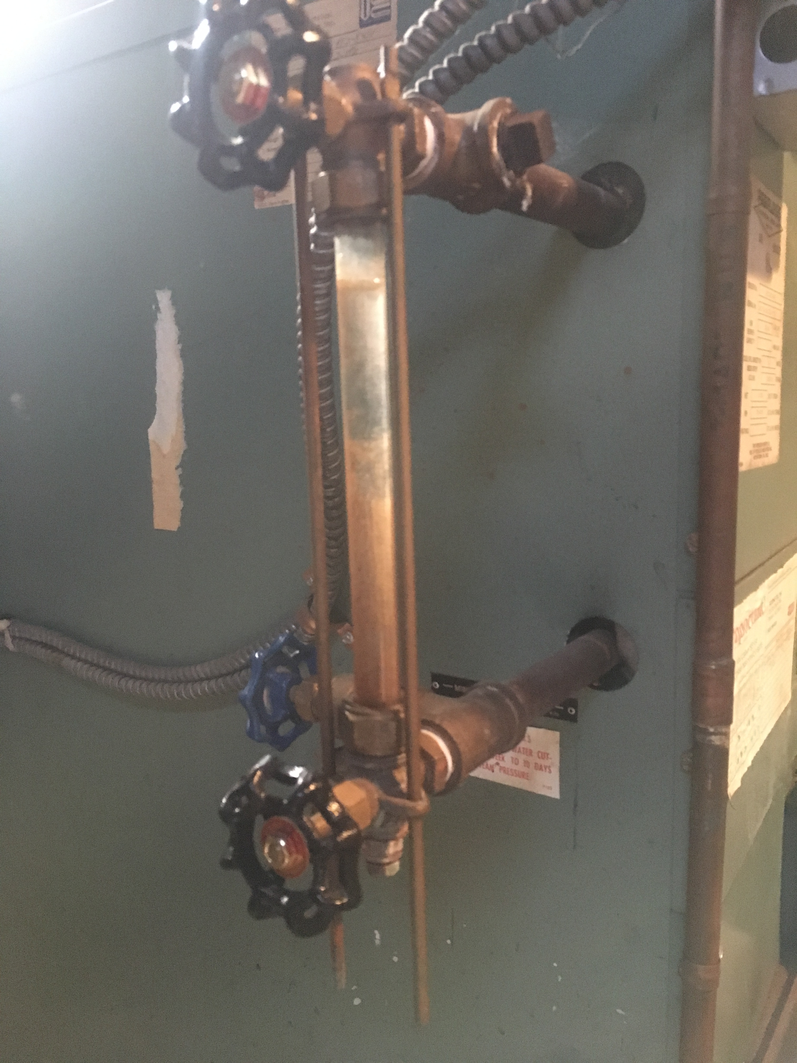

Slide 8
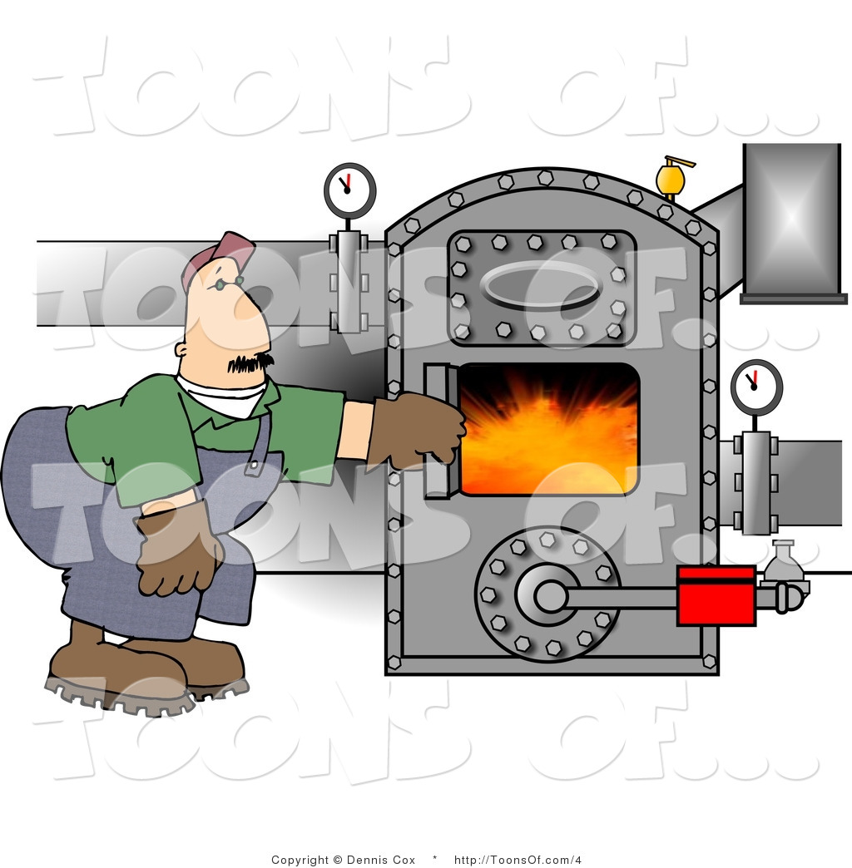
Backflow valve – a backflow valve is a safety device that allows water to flow in a single direction only.
Circulator pump – a circulator pump is used with boilers that use hot water to heat; the circulator pump pushes the hot water through your system, allowing it to circulate to the various outlets.
Supply lines – supply lines are the pipes that deliver the heated water or steam to the distribution points.
Return lines – when the water cools, or the steam cools and changes states back to water, the return lines bring this water back to the boiler for re-heating.

Slide 9
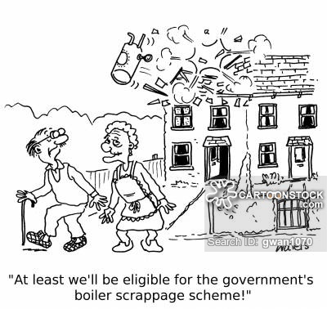
Safety Issues With Boiler
Most Important Issues
Combustion Air
Flue Venting- Flue Liners, Metal Flue Piping, PVC,. Masonry Chimney
Signs Of Maintenance
Isolation Valves
Water Leakage
Age Of Equipment
Steam
Combustion Air
Auto Water Fill Valve
Site Glass Look
Relief Valves
Age Of Equipment

Slide 10
Water Boilers
Most Common
Can Last 30 Years
Signs Of Leakage
Determine Age Serial number
New Efficiency Standards 85%
Main Components
Pump, flue, gas connections, Drain Cock, Air Scoops/Eliminators

Slide 11
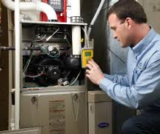
Inspection of Boilers
What’s covered
Gas leaking
Heat Exchanger
Components
Flue Venting
$125 Classic Special for ASHI

Slide 12
This is the most important takeaway that everyone has to remember.
“Should have a Boiler Professional inspect a boiler”

Slide 13
Thanks!
Michael Stein | Classic Aire Care | 314-220-2998 | mike@cacstl.com

