Slide 1
Air Conditioning
Michael Stein

Slide 2

History of A/C & Carrier
1902 Dr Willis Carrier Completes Drawings For 1st A/C
1914 1st House Air Conditioned Charles Gates Mansion In Minneapolis
1922 Grauman’s Theater Los Angeles Is Air Conditioned
1924 First Department Store Jl Hudsons Detroit Air Conditioned
1928 Us House Of Representatives Air Conditioned
1941-1945 Warships And Cargo Ships Air Conditioned
1946 First Bus San Antonio, Texas United Nations
1950 Dr Willis Carrier Dies
1952 First Residential Central A/C Goes On Market St Louis Missouri
1965 Huston Astro Dome Is Air Conditioned By Carrier
1993 Sistine Chapel Air Conditioned With A Carrier
1996 Carrier Introduces Puron -1st Unit In homes
1998 George Washington's Mt Vernon Cooled With Carrier
1998 Cover Time Magazine Dr Willis Carrier “100 Most Influential People Of The Century
2004 Carrier Cools The Olympics In Greece

Slide 3
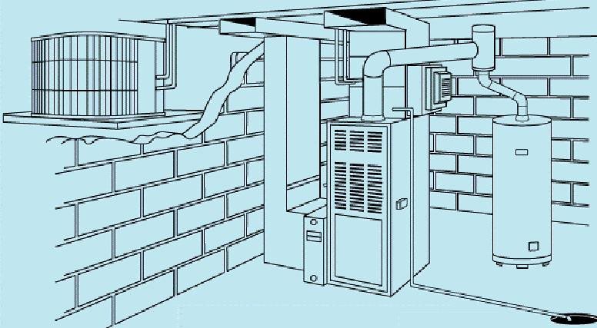
How Does The AC Work?
We take heat out of your house
We take moisture out of your house
We don’t make the air cold?

Slide 4
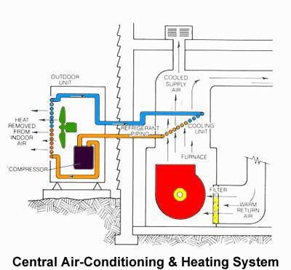
Take The Heat Outside
Capture the heat & move it outside
Capture the water/humidity move outside

Slide 5
What Is A SEER Or EER?
SEER
  Seasonal Energy Efficiency Ratio; a measure of cooling efficiency for air conditioners and heat pumps. The higher the SEER, the more energy efficient the unit.
  95, 87, & 80 outside
  An Average Efficiency
EER
  Energy Efficiency Ratio (steady state)
  95 degree outside & 80 degree inside
  Worst Case Efficiency

Slide 6
What Does This Mean?
Ton
A unit of measurement used for determining cooling capacity. One ton is the equivalent of 12,000 BTUs per hour.
Two-stage heating/Two-stage cooling
Two-stage heating and cooling is considered to be more efficient, because it operates at low speed most of the time. However, on days when more heating or air conditioning is required, it switches to the next stage for maximum comfort.
Split system (also indoor/outdoor system)
The combination of an outdoor unit (air conditioner or heat pump) with an indoor unit (furnace or air handler). Split systems must be matched for optimum efficiency.
Load calculation
Assessed by a dealer, the calculation factors in a number of criteria in your home (square footage, number of windows, year-round weather concerns) and determines what size components you should include as part of your total comfort system
ASHRAE
American Society of Heating, Refrigeration and Air Conditioning Engineers
SET SEER & EER STANDARDS

Slide 7
Sizing –Rule Of Thumb
Up to 850 sq ft 2 ton
Up to 1400 sq ft 2 ½ ton
Up to 1800 sq ft 3 ton
Up to 2100 sq ft 3 ½ ton
Up to 2500 sq ft 4 ton
Over 2500 sq ft 5 ton
Other factors brick, west exposure, vaulted ceilings, poor windows

Slide 8
Problems With Install
Studies show that the average 13
Seer when measured is a 7.2 seer…why?
  The way it installed
  Refrigerant charge
  Duct work leaks
  Duct sizing
  Unit sizing
  Inside coil

Slide 9
Duct Work Issues
Return 80 square inches per ton
Supply 70 square inches per ton
Supply rule of thumb
  4 registers per ton
Return rule of thumb
  (1) 30” wide return air in wall per ton
Air leakage around coil
No holes in return air drop

Slide 10
Problems With The Condensing Unit
Not level
No exposed wires by disconnect
Under deck
Too close to walls or bushes
Require 16”
Damage to fins
  Bad cabinets
  6” square lowers 1 seer
Dog pee problems
Long lines issues
Dirty
No maintenance record
No oil around Schrader values
Cap’s for Schrader values

Slide 11
Problems With Inside Coil-“the Evaporator Coil”
Really old = very inefficient
  Changed outside unit but not the coil
  Efficiency comes mostly from the coil
  The tires of the car = the coil
Cased vs uncased
Air leakage out lines
Make sure connection caulked- no leakage
No oil anywhere
Dirty coils = dirty filters or no filters
Condensate around top of coil = blockage
No filter
18 to 22 degree temp drop “td”
  Measure at filter & then above coil

Slide 12
Problems With Inside Coil
“The Evaporator Coil” - Continued
Kinked lines by the coil
Water marks on furnace
Arma flex all the way to the sheet metal
Support for the refrigerant lines
Not square with the furnace
  Sticking out too much

Slide 13
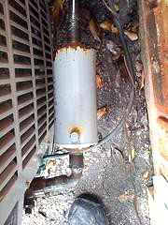
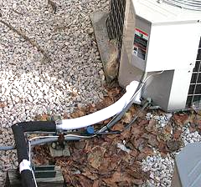
Refrigerant Line Problems
Kink lines
1/16 vs 3/8 insulation arma flex
Cover all the lines
Correct sizing
  3/8 x 5/8 2 ton
  3/8 x ¾ 2 ½ ton to 3 ton
  3/8 x 7/8 3 ½ ton to 5 ton
Outside lines no 90 degree bends without fitting
Supported along ceiling inside
Attached to wall outside
Not sealed coming out of coil
Not sealed coming out of house
No oil around fittings
Driers outside-liquid & suction
  Not meant for outside use
Lines in the ground- big no no

Slide 14
Parts Of An Air Conditioner
Service values
Filter driers
Fan motor
Compressor
  Scroll
  Reciprocating
Pressure switches
Heat pump parts
Circuit boards

Slide 15
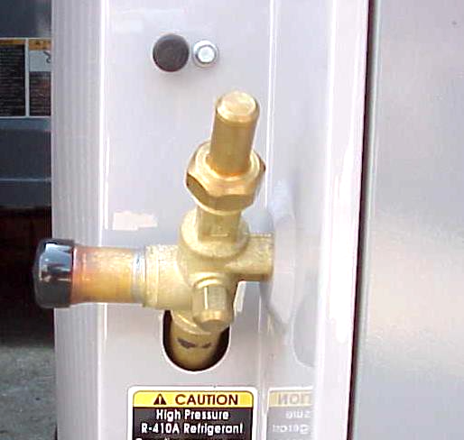
Liquid Line Service Valves
Back seating valves
Caution label
  R-410A
  POE Oil
Heat pump
Suction pressure reading in either heating or cooling mode
Suction Pressure

Slide 16
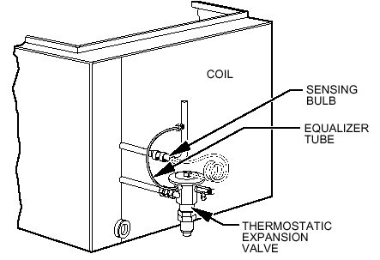
Thermostatic Expansion Valve

Slide 17
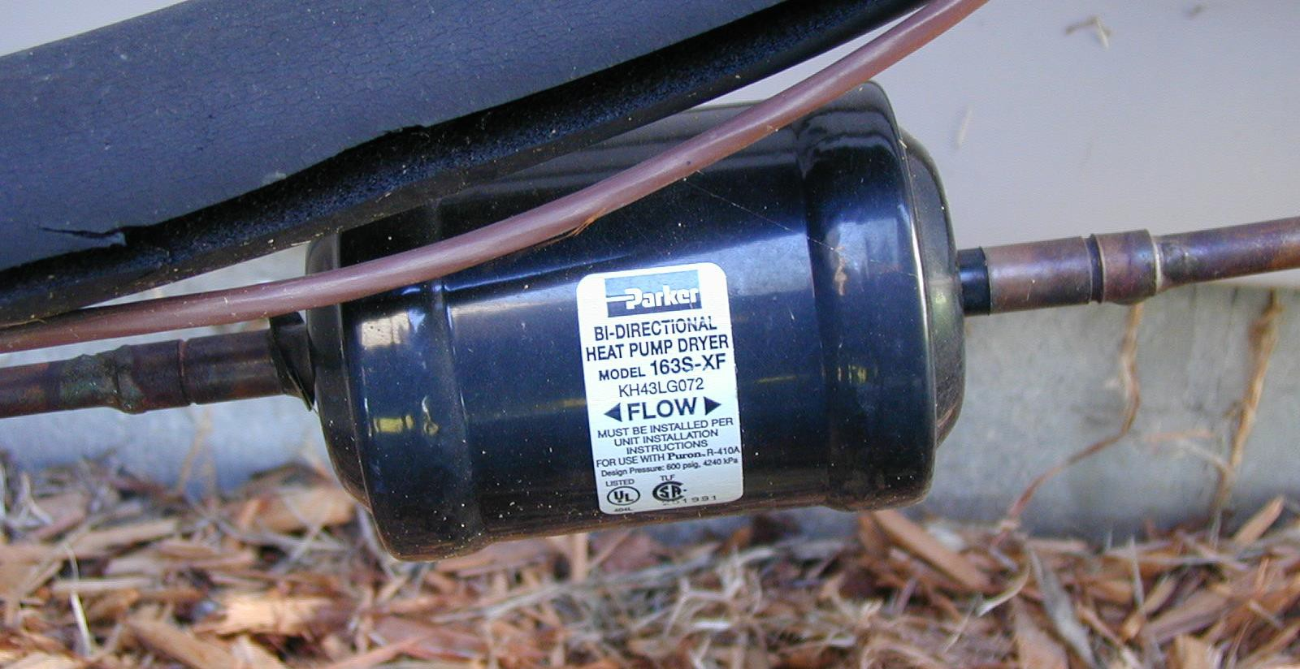
Filter Drier

Slide 18
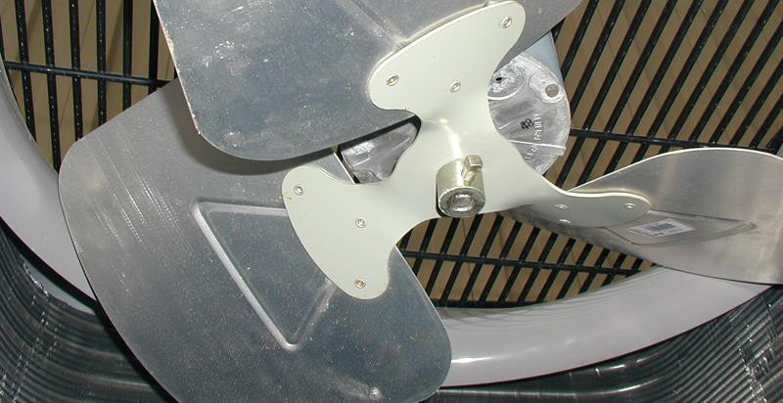
Single-Speed Fan Motor & Fan

Slide 19
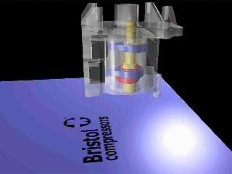
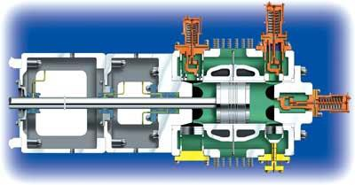
Twin-Single Recip. Mechanism

Slide 20
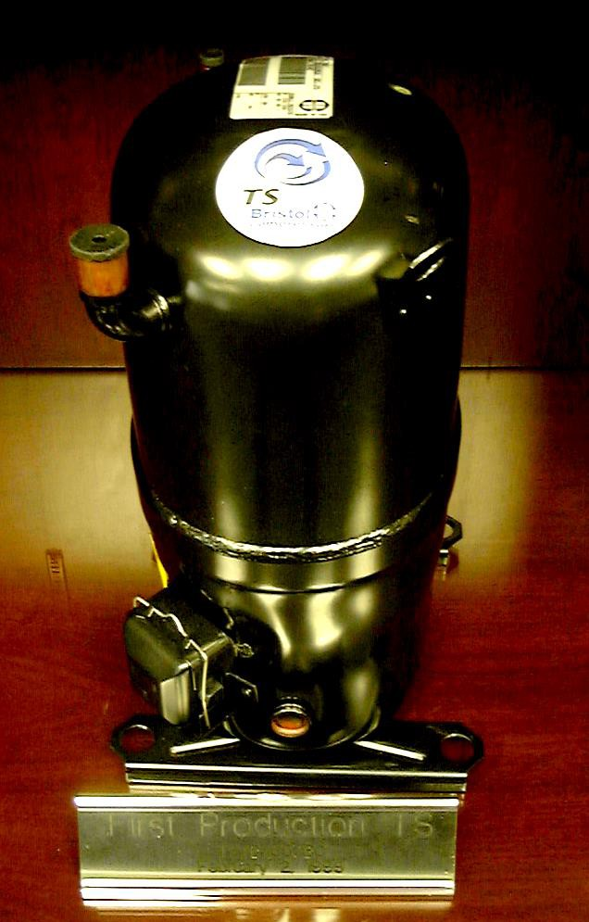
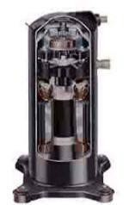
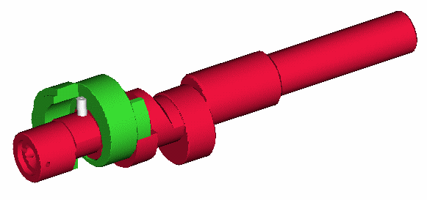
Bristol Dual SCROLL Capacity Compressor

Slide 21
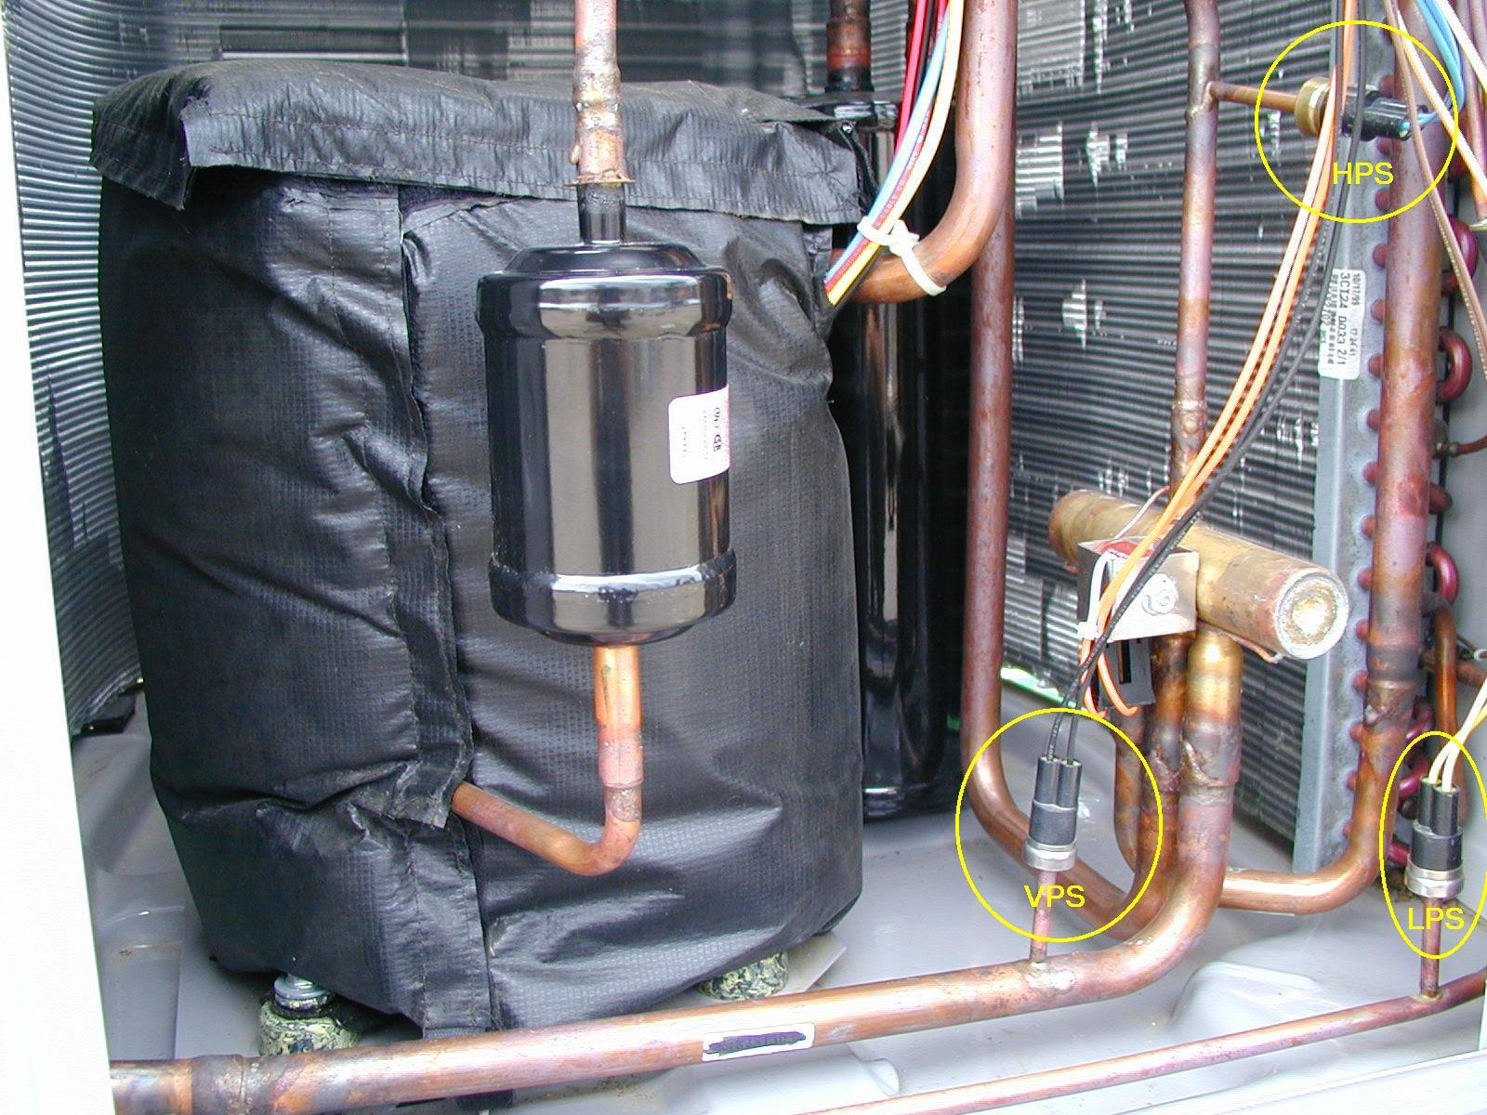
Low and High Pressure Switches
HPS
LPS

Slide 22
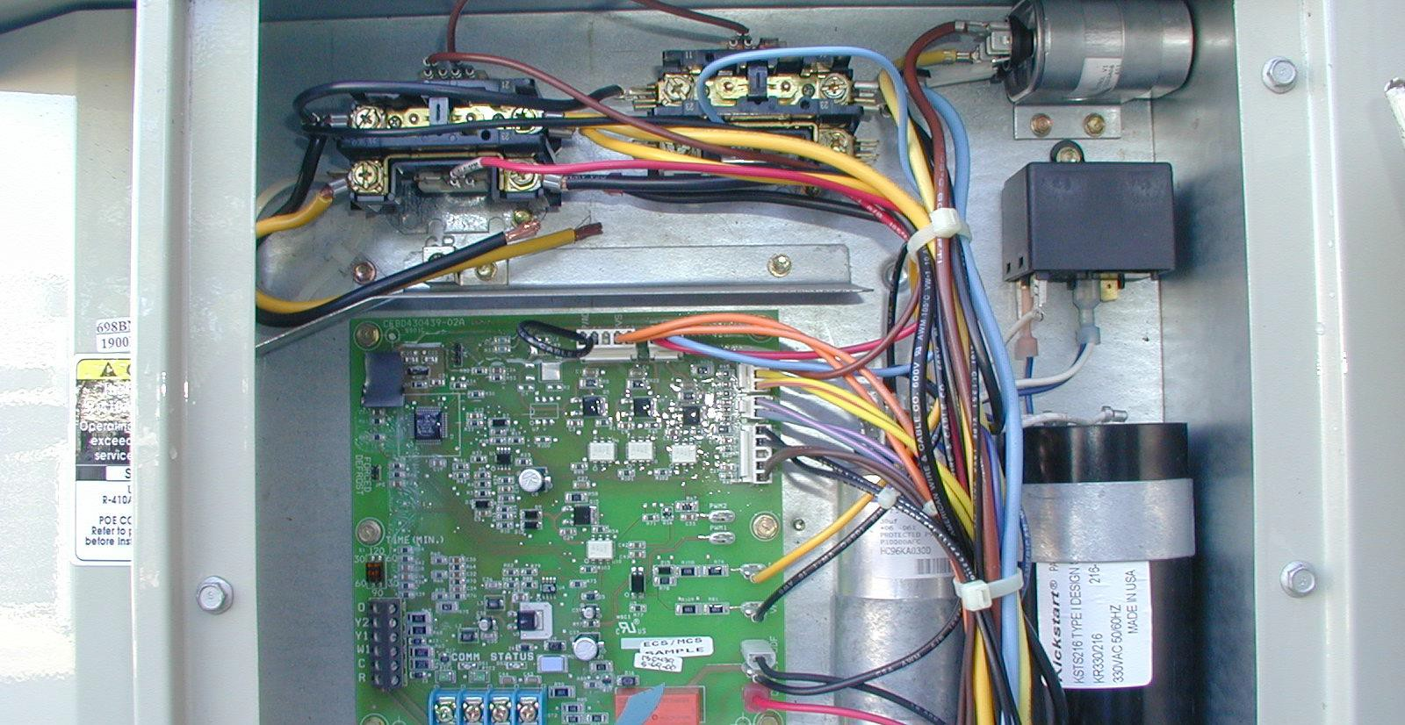
Controls Enclosure
High Capacity Contactor
Low Capacity Contactor
Outdoor Fan Capacitor

Slide 23
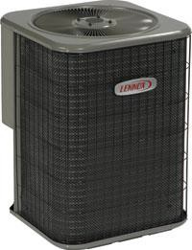
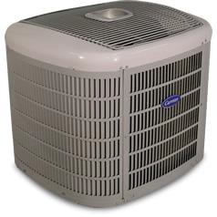
CABINET
Protection of fins & coils

Slide 24
Puron “The New Gas”
Save The World One AC at a Time

Slide 25

The History Of Puron
1990 clean air act
  PHASE OUT 2010 R22 equipment
  Phase out R22 production 2016
2005 9% of industry sales were Puron
2015 98% of industry sales were Puron

Slide 26
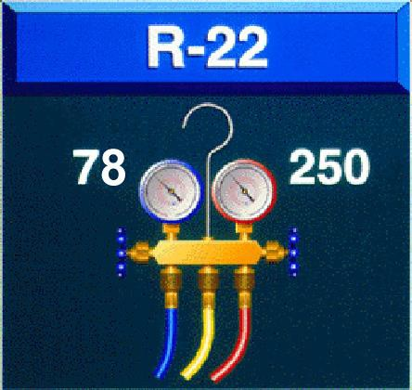
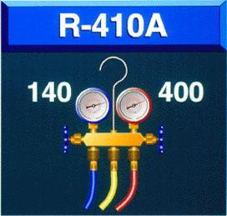
Typical Operating Pressures

Slide 27
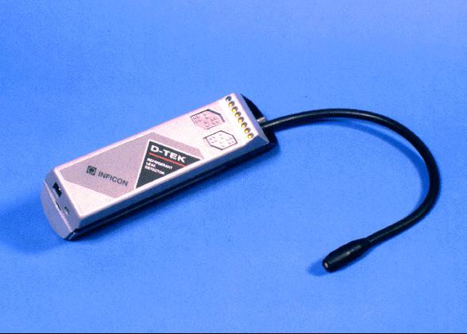
Leak Detectors
Make sure detector is HFC compatible

Slide 28
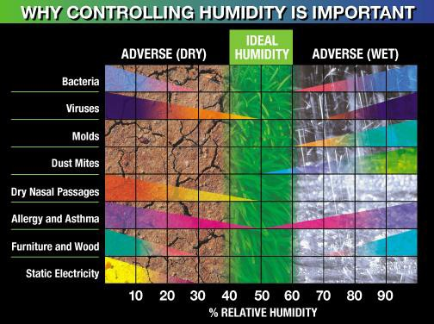
IdealHumidity Systems Controlling

Slide 29


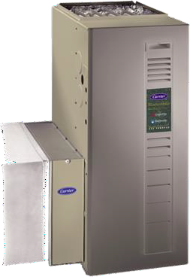

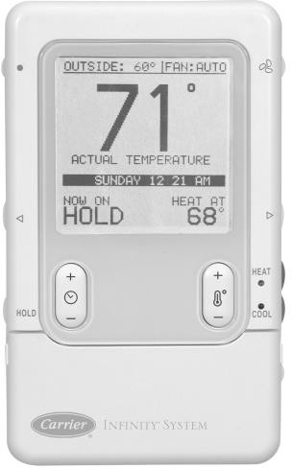
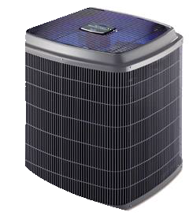
IdealHumidity Systems
Controlling High Humidity
29

Slide 30

IdealHumidity Systems
Controlling High Humidity
IdealHumidity System
Too much humidity in the air causes homeowners to feel hot and sticky
Carrier’s IdealHumidity System allows you to take the steam out of summer!
Plus, it can remove unwanted humidity even without a call for cooling!

Slide 31

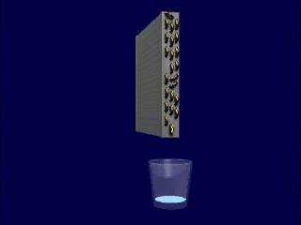
IdealHumidity Systems
Controlling High Humidity
Remove more water?
  Slow down the air!

Slide 32
IdealHumidity Systems-Controlling High Humidity
Example-
Temp set point: 78 deg.
Humidity set point: 51%
Humidity Set Point
80º
Room Temperature
78º
Temperature Set Point
76º
74º
47
49
51 53 55
Relative Humidity (%)
57
59

Slide 33
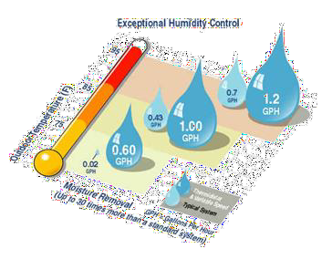
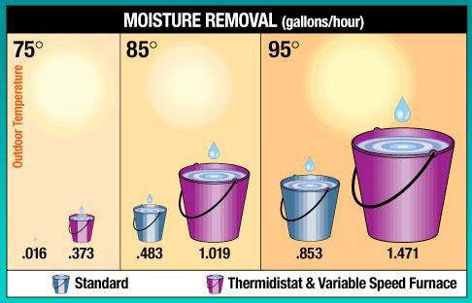
IdealHumidity Systems
Controlling High Humidity
IdealHumidity System
Removes up to 30 times more moisture per day
  Can remove over 1/2 gallon more moisture per hour

Slide 34
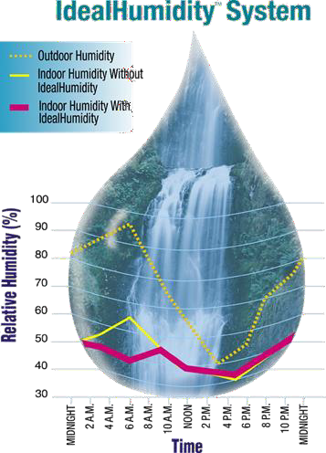
IdealHumidity Systems
Controlling High Humidity
Humidity can build up during the night when there is little need for cooling. That leaves occupants feeling “sticky” when they awake.
  Carrier’s IdealHumidity System will continue removing moisture from the air, when most systems aren’t operating

Slide 35
IdealHumidity Systems in Action
INDOOR RELATIVE HUMIDITY
 |  |  | 10% | 20% | 30% | 40% | 50% | 60% | 70% | 80% | 90% | 100%
 |  | 76 |  | 60 | 63 | 67 | 70 | 73 | 76 | 79 | 82 | 85
C T |  | 78 |  | 63 | 67 | 70 | 74 | 76 | 79 | 82 | 85 | 89
O E |  | 80 | 62 | 66 | 70 | 73 | 77 | 80 | 83 | 86 | 90 | 93
O M |  | 82 | 63 | 68 | 73 | 76 | 80 | 83 | 86 | 90 | 93 | 97
L | P | 84 | 66 | 71 | 76 | 79 | 83 | 86 | 90 | 94 | 98 | 103
I | E | 86 | 68 | 73 | 78 | 82 | 86 | 90 | 94 | 98 | 103
N | R | 88 | 70 | 76 | 81 | 85 | 89 | 93 | 98 | 102 | 108
G | A | 90 | 73 | 78 | 84 | 88 | 93 | 97 | 102 | 108
 | T | 92 | 75 | 82 | 87 | 91 | 96 | 101 | 106 | 112
S | U | 94 | 77 | 84 | 90 | 95 | 100 | 107 | 111
E | R | 96 | 79 | 87 | 93 | 98 | 103 | 110 | 116
T | E | 98 | 82 | 90 | 96 | 101 | 107 | 114
 |  | 100 | 85 | 92 | 99 | 105 | 111 | 118
 | (F) | 102 | 87 | 95 | 102 | 108 | 115 | 123
 |  | 104 | 90 | 98 | 106 | 112 | 120
Summer Heat Index
AT TEMPERATURE
SETTING OF………
AT THIS HUMIDITY
LEVEL…….
IT FEELS LIKE……
Note: HEAT INDEX data courtesy of the U.S. Weather Bureau

Slide 36

Drier than the Desert

Slide 37
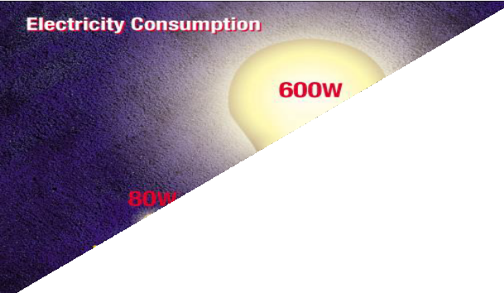
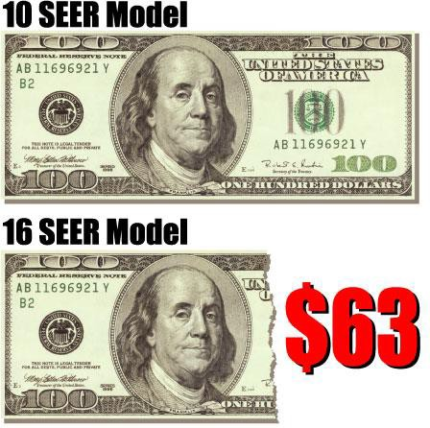
Energy Savings
Most Energy Efficient Comfort System in The World….
AFUE up to 96.6% saves on gas bill
As little as a 80W light bulb in heating
As little as a 50W light bulb in continuous fan
Enjoy Energy Savings in Cooling….
Two Speed Puron Plus
Run almost 80% of time in low speed
Enjoy ultra high efficiency (16 SEER)
Save nearly 40% on outdoor unit operating costs
80W

Slide 38
Heat Pump
Air source
300% efficient
Reversing value
“Hybrid” HEAT

Slide 39
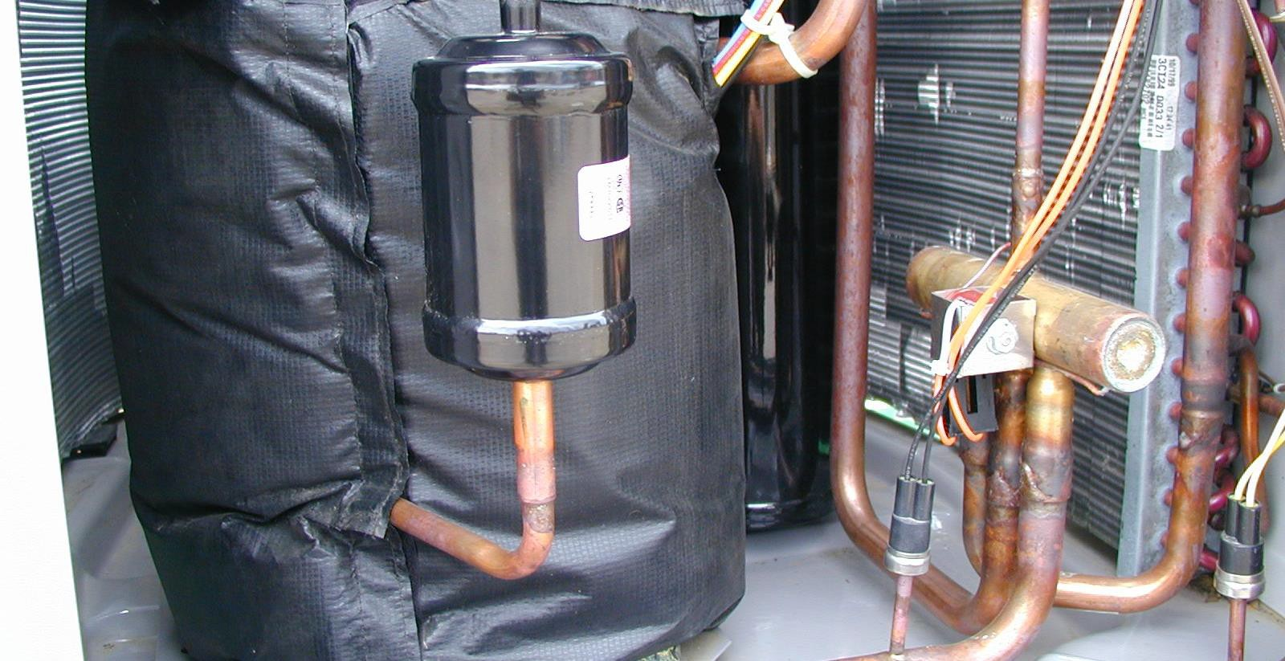
Muffler, Accumulator, Reversing Valve
Muffler
r
Accumulator
Reversing Valve

Slide 40
The Future
Heat pumps air & ground
  Hybrid heating
  Gas furnace with a heat pump
Tax rebates for heat pumps
Variable speed motors
  Operate 1/10 the power as a normal ac blower motor
Sophisticated controls “infinity”
  Control temperature and humidity
More focus on the contractor & training

Slide 41
Questions

