Slide 1
Advanced Electrical
The 35 Most Missed & Misunderstood
Electrical Inspection Items
Dave Haught, ACI, MIES, EP

Slide 2
The 35 Most Missed & Misunderstood
Electrical Inspection Items
I want to avoid a boring two hour long-dry lecture….
With participation, I believe we can have an exciting informational and enjoyable
two hours.
Answer with a show of hands…..

Slide 3
The 35 Most Missed & Misunderstood Electrical Inspection Items
T F 1. The National Electrical Code is written with clear explanatory language so that it can meet the intent of being understood by persons without specialized training.

Slide 4
T F 1. The National Electrical Code is written with clear explanatory language so that it can meet the intent of being understood by persons without specialized training.
False
NEC 2014 [90.1(C)] “The NEC is a set of rules. Not a set of explanations”

Slide 5
The 35 Most Missed & Misunderstood
Electrical Inspection Items
Let’s Start outside at the service drop or service lateral.
All of you are aware of the depth of underground service laterals 24 inches and 36 under driveways…..
And we learned the heights for Service Drops

Slide 6
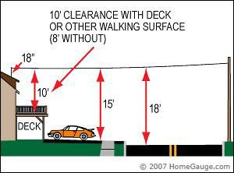
The 35 Most Missed & Misunderstood
Electrical Inspection Items
And we learned the heights for Service Drops

Slide 7
The 35 Most Missed & Misunderstood
Electrical Inspection Items
We all understand that we have three conductors to the home on a single phase service. Two Hot (120 volt) and a neutral.

Slide 8
The 35 Most Missed & Misunderstood
Electrical Inspection Items
What would you rather loose one of the two hot. (loosing ½ the power in the home) or the neutral? (The home would rely on the grounding system to complete the circuit)
Show of hands Hot?
Neutral?

Slide 9
The 35 Most Missed & Misunderstood
Electrical Inspection Items
Lets think about where the electric flows in the circuit.

Slide 10

The 35 Most Missed & Misunderstood
Electrical Inspection Items
Let’s Start with the toaster or any appliance in the home.

Slide 11
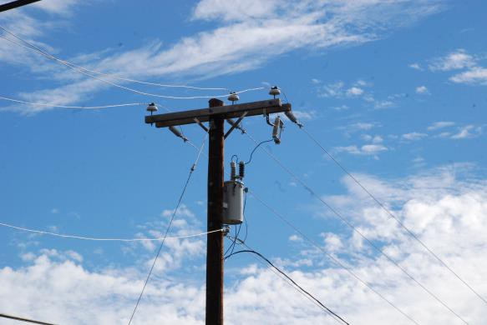
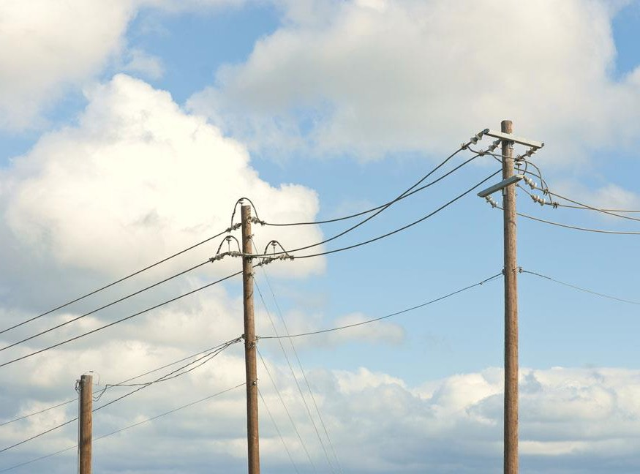
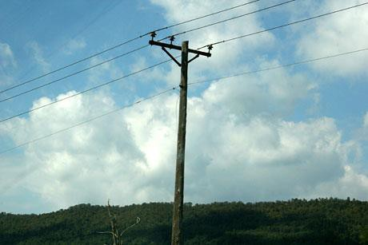
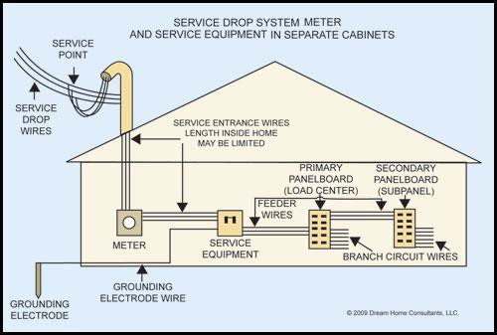
The 35 Most Missed & Misunderstood
Electrical Inspection Items
The electrical flow starts at the generation plant.
Goes through the distribution system to a Transformer in your neighborhood

Slide 12
The 35 Most Missed & Misunderstood
Electrical Inspection Items
The electrical flow continues along utility electric lines until it reaches your home

Slide 13
The 35 Most Missed & Misunderstood
Electrical Inspection Items
The electrical flow continues along utility electric lines until it reaches your home

Slide 14
The 35 Most Missed & Misunderstood
Electrical Inspection Items
The electrical flow continues along utility electric lines until it reaches your home

Slide 15
The 35 Most Missed & Misunderstood
Electrical Inspection Items
The electrical flow continues along utility electric lines until it reaches your home through a lateral drop

Slide 16
The 35 Most Missed & Misunderstood
Electrical Inspection Items
Then through the main panel and to the toaster

Slide 17
The 35 Most Missed & Misunderstood
Electrical Inspection Items
Then through the main panel and to the toaster

Slide 18
The 35 Most Missed & Misunderstood
Electrical Inspection Items
So this is what we get…..

Slide 19

The 35 Most Missed & Misunderstood
Electrical Inspection Items
Back to its source the transformer
Normal Circuit flow of electric

Slide 20

The 35 Most Missed & Misunderstood
Electrical Inspection Items
Normal Circuit flow of electric

Slide 21

The 35 Most Missed & Misunderstood
Electrical Inspection Items
Normal Circuit flow of electric

Slide 22

The 35 Most Missed & Misunderstood
Electrical Inspection Items
Normal Circuit flow of electric

Slide 23
The 35 Most Missed & Misunderstood
Electrical Inspection Items
Normal Circuit flow of electric

Slide 24

The 35 Most Missed & Misunderstood
Electrical Inspection Items
Normal Circuit flow of electric

Slide 25
The 35 Most Missed & Misunderstood
Electrical Inspection Items
Normal Circuit flow of electric

Slide 26


The 35 Most Missed & Misunderstood
Electrical Inspection Items
Normal Circuit flow of electric

Slide 27

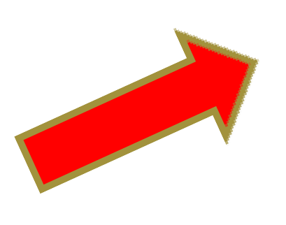
The 35 Most Missed & Misunderstood
Electrical Inspection Items
Toaster heats Toast pops up
Normal Circuit flow of electric

Slide 28
The 35 Most Missed & Misunderstood
Electrical Inspection Items
Toaster heats Toast pops up
Circuit starts Return trip
Normal Circuit flow of electric

Slide 29
The 35 Most Missed & Misunderstood
Electrical Inspection Items
Normal Circuit flow of electric

Slide 30

The 35 Most Missed & Misunderstood
Electrical Inspection Items
Normal Circuit flow of electric

Slide 31

The 35 Most Missed & Misunderstood
Electrical Inspection Items
Normal Circuit flow of electric

Slide 32
The 35 Most Missed & Misunderstood
Electrical Inspection Items
Normal Circuit flow of electric

Slide 33
The 35 Most Missed & Misunderstood
Electrical Inspection Items
Normal Circuit flow of electric

Slide 34

The 35 Most Missed & Misunderstood
Electrical Inspection Items
Normal Circuit flow of electric

Slide 35

The 35 Most Missed & Misunderstood
Electrical Inspection Items
Normal Circuit flow of electric

Slide 36

The 35 Most Missed & Misunderstood
Electrical Inspection Items
Normal Circuit flow of electric

Slide 37

The 35 Most Missed & Misunderstood
Electrical Inspection Items
Normal Circuit flow of electric

Slide 38
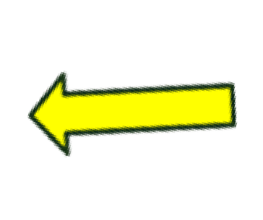
The 35 Most Missed & Misunderstood
Electrical Inspection Items
Normal Circuit flow of electric

Slide 39
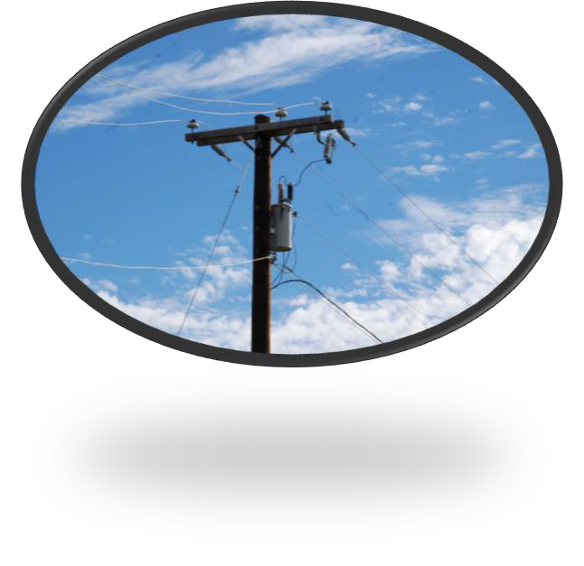
The 35 Most Missed & Misunderstood
Electrical Inspection Items
The Circuit is “completed” at the Transformer

Slide 40
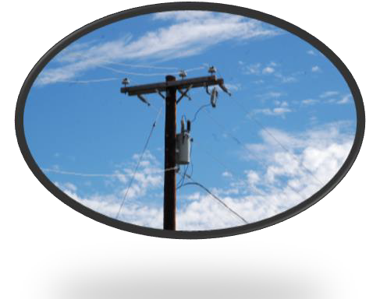
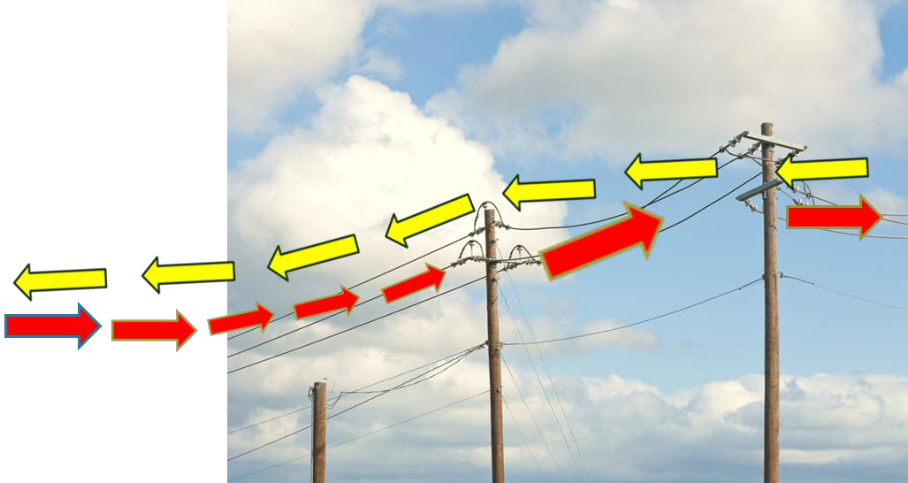
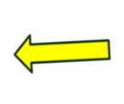
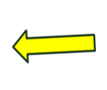



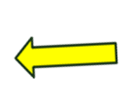



The 35 Most Missed & Misunderstood
Electrical Inspection Items
Circuit is “completed” at the Transformer

Slide 41
The 35 Most Missed & Misunderstood
Electrical Inspection Items
What Happens if one of the two Hot lateral Wires are Cut?

Slide 42

The 35 Most Missed & Misunderstood
Electrical Inspection Items
What Happens if one of the two Hot lateral Wires are Cut?
Show of hands….
Nothing? Toast

Slide 43
The 35 Most Missed & Misunderstood
Electrical Inspection Items
What Happens if one of the two Hot lateral Wires are Cut?
Show of hands….
No Toast?

Slide 44
The 35 Most Missed & Misunderstood
Electrical Inspection Items
Picture in your mind what we have….
Remember we have two hot (120v) service laterals.
It depends which one is cut.

Slide 45
The 35 Most Missed & Misunderstood
Electrical Inspection Items
Picture in your mind what we have….
Remember we have two hot (120v) service laterals.
It depends which one is cut.
You had a 50/50 chance of being right...

Slide 46
The 35 Most Missed & Misunderstood
Electrical Inspection Items
Picture in your mind what we have….
Remember we have two hot (120v) service laterals.
It depends which one is cut.

Slide 47

The 35 Most Missed & Misunderstood
Electrical Inspection Items
OK What Happens, if the neutral wire to the Toaster is Cut?
(between receptacle & Toaster)

Slide 48
The 35 Most Missed & Misunderstood
Electrical Inspection Items
What Happens if the neutral wire to toaster is Cut?
Show of hands….
Nothing? Toast

Slide 49
The 35 Most Missed & Misunderstood
Electrical Inspection Items
What Happens if the neutral wire to toaster is Cut?
Show of hands….
Nothing? Toast

Slide 50
The 35 Most Missed & Misunderstood
Electrical Inspection Items
What happened if the neutral wire to the toaster is Cut?
No Toast

Slide 51
The 35 Most Missed & Misunderstood
Electrical Inspection Items
What Happens if the neutral on the overhead service lateral is broken or cut ?

Slide 52
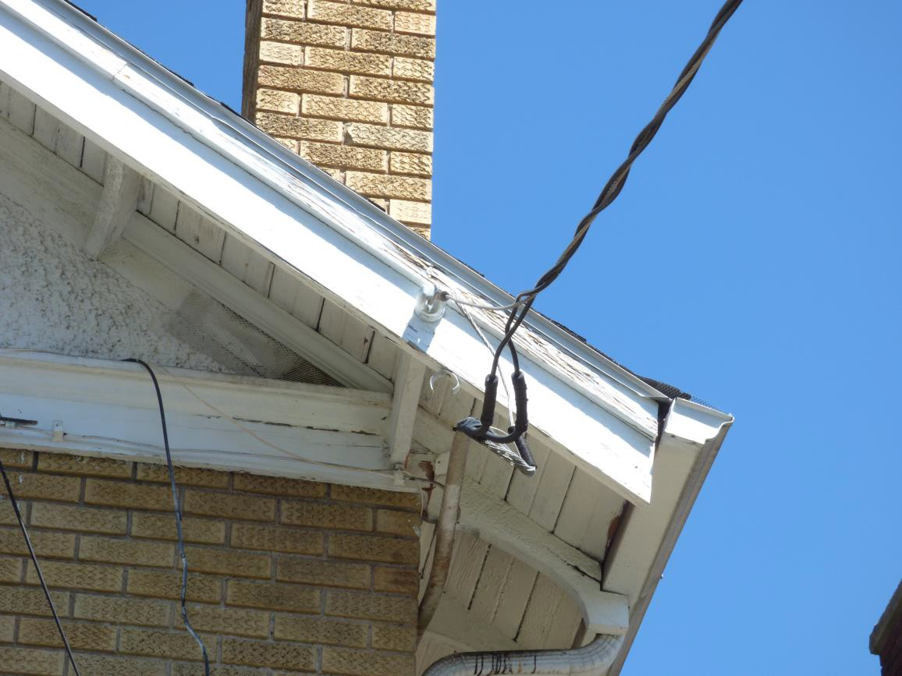
The 35 Most Missed & Misunderstood
Electrical Inspection Items
Tell – Tell Signs of cut or broken Neutral

Slide 53
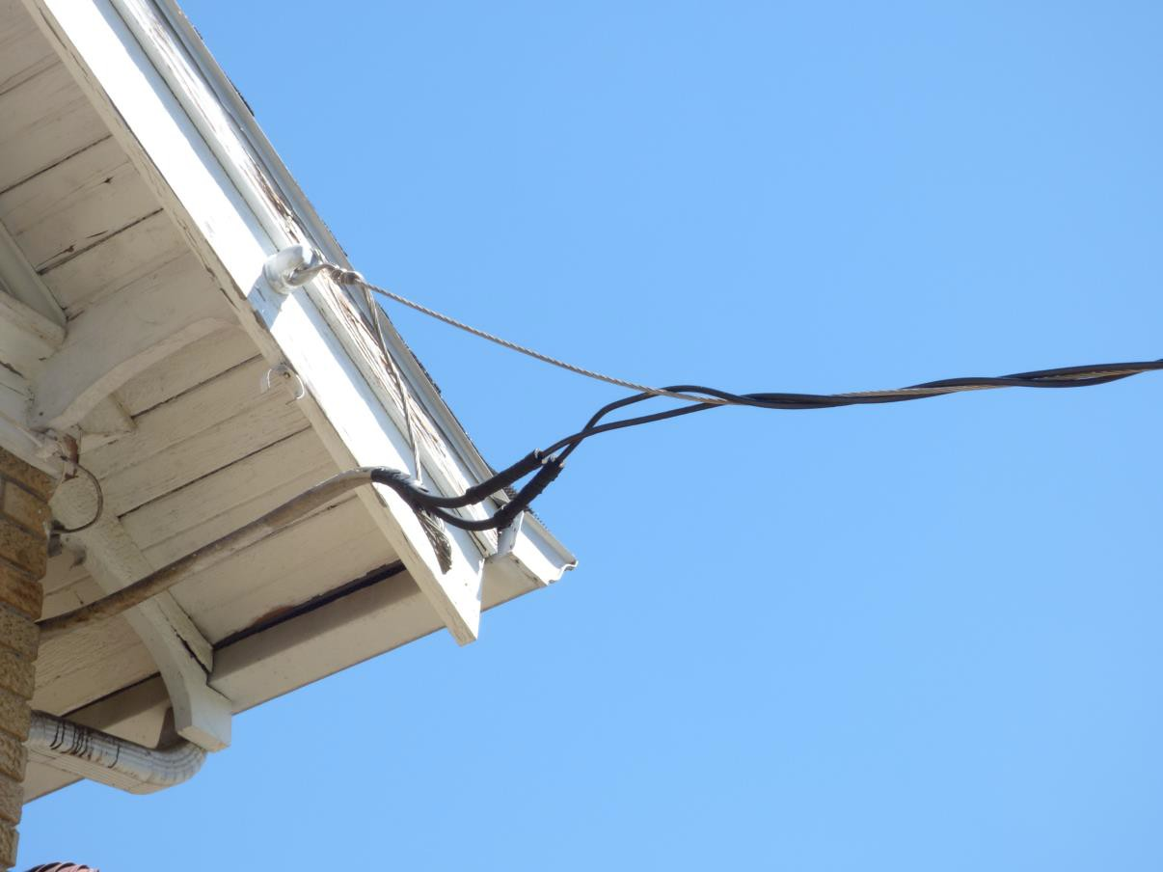
The 35 Most Missed & Misunderstood
Electrical Inspection Items
No drip loop-hot conductors with tension

Slide 54
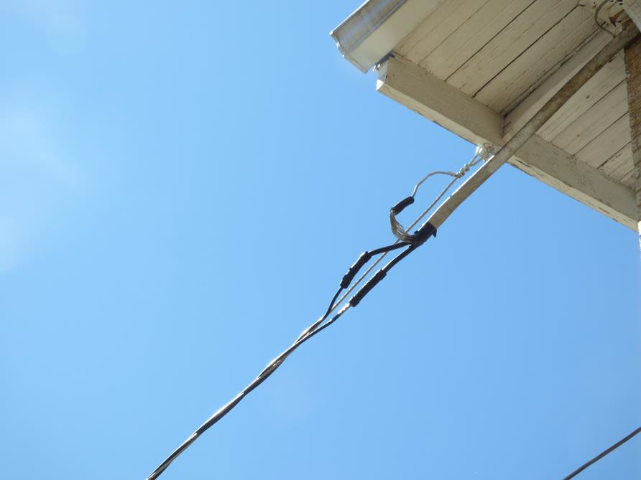
The 35 Most Missed & Misunderstood
Electrical Inspection Items
No drip loop-hot conductors with tension

Slide 55
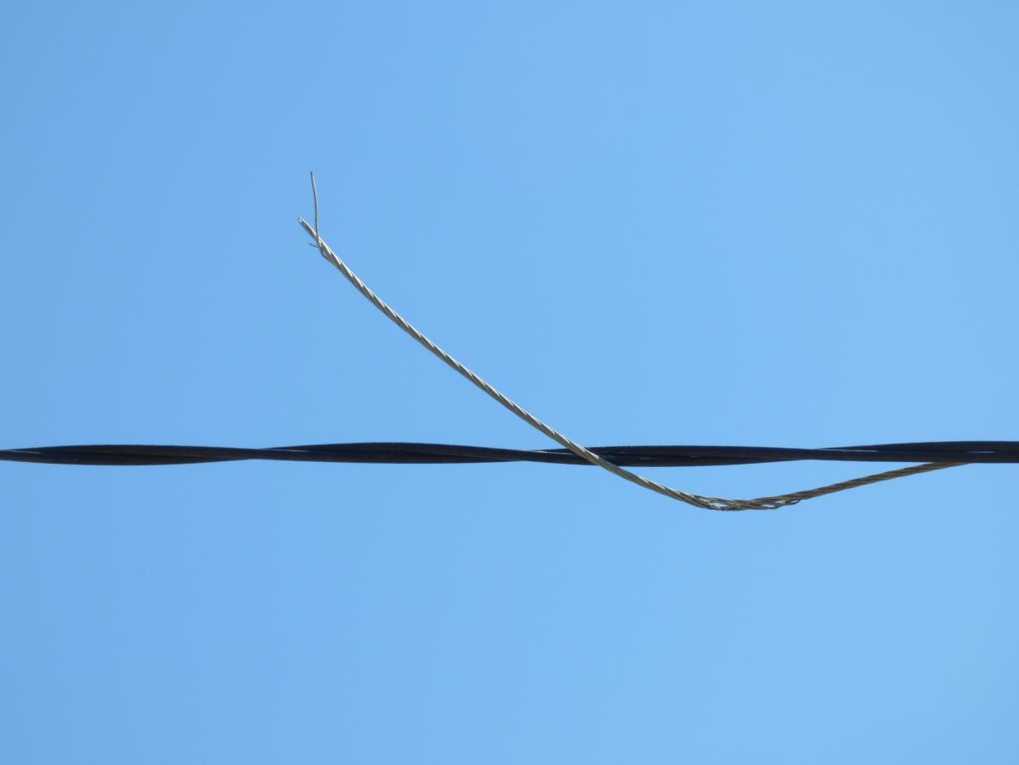
The 35 Most Missed & Misunderstood
Electrical Inspection Items
Cut or broken Neutral

Slide 56
The 35 Most Missed & Misunderstood
Electrical Inspection Items
Cut or broken Neutral
OK What Happens, if the neutral is broken or cut?

Slide 57
The 35 Most Missed & Misunderstood
Electrical Inspection Items
Let’s return to our trusty Toaster example.

Slide 58
The 35 Most Missed & Misunderstood
Electrical Inspection Items
What Happens if the neutral lateral wire is Cut?
Show of hands….
Nothing? Toast

Slide 59
The 35 Most Missed & Misunderstood
Electrical Inspection Items
What Happens if the neutral lateral wire is Cut?
Show of hands….
No Toast

Slide 60

The 35 Most Missed & Misunderstood
Electrical Inspection Items
What Happens if the neutral wire to toaster is Cut?
Toast

Slide 61
So…Who Cares?
We got toast!

Slide 62
The 35 Most Missed & Misunderstood
Electrical Inspection Items
Remember current flows from the transformer…..

Slide 63
The 35 Most Missed & Misunderstood
Electrical Inspection Items
Back to its source the transformer
Current flows along the electrical lines

Slide 64
The 35 Most Missed & Misunderstood
Electrical Inspection Items
Current flows along the electrical lines

Slide 65
The 35 Most Missed & Misunderstood
Electrical Inspection Items
Current flows along the electrical lines

Slide 66
The 35 Most Missed & Misunderstood
Electrical Inspection Items
Current flows along the electrical lines

Slide 67
The 35 Most Missed & Misunderstood
Electrical Inspection Items
Current flows along the electrical lines

Slide 68
The 35 Most Missed & Misunderstood
Electrical Inspection Items
Current flows along the electrical lines

Slide 69
The 35 Most Missed & Misunderstood
Electrical Inspection Items
Current flows along the electrical lines

Slide 70
The 35 Most Missed & Misunderstood
Electrical Inspection Items
Current flows along the electrical lines

Slide 71
The 35 Most Missed & Misunderstood
Electrical Inspection Items
Toaster heats Toast pops up
Current flows along the electrical lines

Slide 72
The 35 Most Missed & Misunderstood
Electrical Inspection Items
Toaster heats Toast pops up Circuit starts Return trip
Current flows along the electrical lines In the house to the panel

Slide 73
The 35 Most Missed & Misunderstood
Electrical Inspection Items
Current flows along the electrical lines In the house to the panel

Slide 74
The 35 Most Missed & Misunderstood
Electrical Inspection Items
Current flows along the electrical lines In the house to the panel

Slide 75
The 35 Most Missed & Misunderstood
Electrical Inspection Items
BUT The neutral to the transformer is cut / broken !

Slide 76
The 35 Most Missed & Misunderstood
Electrical Inspection Items
STOP
BUT The neutral to the transformer is cut / broken !

Slide 77

The 35 Most Missed & Misunderstood
Electrical Inspection Items
STOP
Unlike the toaster cord there is an alternate neutral path to the transformer

Slide 78






The 35 Most Missed & Misunderstood
Electrical Inspection Items
The path has to be the home’s grounding system

Slide 79
The 35 Most Missed & Misunderstood
Electrical Inspection Items
Neutral’s path to ground with a lot of resistance

Slide 80
The 35 Most Missed & Misunderstood
Electrical Inspection Items
Neutral’s path to ground with a lot of resistance

Slide 81
The 35 Most Missed & Misunderstood
Electrical Inspection Items
Neutral’s path to ground with a lot of resistance

Slide 82
The 35 Most Missed & Misunderstood
Electrical Inspection Items
Neutral’s path to ground with a lot of resistance

Slide 83
The 35 Most Missed & Misunderstood
Electrical Inspection Items
Neutral’s path to ground with a lot of resistance

Slide 84

The 35 Most Missed & Misunderstood
Electrical Inspection Items
Neutral’s path to ground with a lot of resistance

Slide 85


The 35 Most Missed & Misunderstood
Electrical Inspection Items
The circuit is “Complete”

Slide 86
The 35 Most Missed & Misunderstood
Electrical Inspection Items
Is the Resistance in the Soil always the Same?

Slide 87
The 35 Most Missed & Misunderstood
Electrical Inspection Items
What is a better conductor dry soil or wet?

Slide 88
The 35 Most Missed & Misunderstood
Electrical Inspection Items
What is a better conductor Aluminum wire or soil?

Slide 89
The 35 Most Missed & Misunderstood
Electrical Inspection Items
Back to my original question….
What happens when the Neutral Lateral is cut or broken?

Slide 90
Let’s go to Ohms Law.

Slide 91
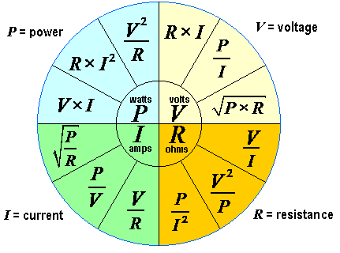
The 35 Most Missed & Misunderstood
Electrical Inspection Items
Let’s go to Ohms Law.

Slide 92
The 35 Most Missed & Misunderstood
Electrical Inspection Items
Let’s go to Ohms Law.

Slide 93

The 35 Most Missed & Misunderstood
Electrical Inspection Items
Let’s go to Ohms Law.

Slide 94
The 35 Most Missed & Misunderstood
Electrical Inspection Items
Let’s go to Ohms Law.

Slide 95
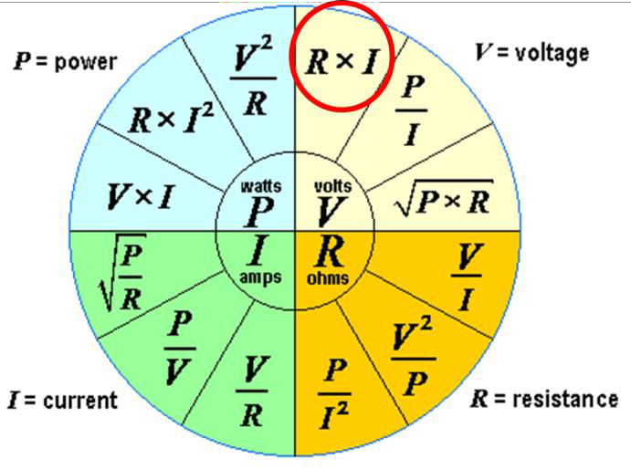
The 35 Most Missed & Misunderstood
Electrical Inspection Items
Let’s go to Ohms Law
Voltage = Resistance x Current
V = R x I

Slide 96
The 35 Most Missed & Misunderstood
Electrical Inspection Items
Let’s go to Ohms Law
Voltage = Resistance x Current
V = R x I
As an example, let’s say Current (I) amps = 200
Resistance is a value of .6. 200 x.6=120v

Slide 97
The 35 Most Missed & Misunderstood
Electrical Inspection Items
Let’s go to Ohms Law
Voltage = Resistance x Current
V = R x I
As an example, let’s say Current (I) amps = 200
Resistance is a value of .6. 200 x.6=120v
If the Resistance increases to 5 200 x5 =1,000v !

Slide 98
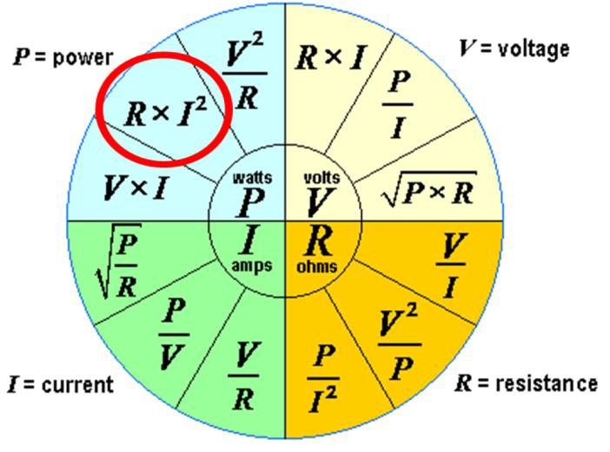
The 35 Most Missed & Misunderstood
Electrical Inspection Items
Let’s go to Ohms Law
Power (Watts) = Resistance x I²
P = R x I²

Slide 99
The 35 Most Missed & Misunderstood
Electrical Inspection Items
Let’s go to Ohms Law
Power (Watts) = Resistance x I²
P = R x I²
Again resistance is .6 and amperage 200
P = .6 x 200² .6 x 40,000 = 24,000 watts
Resistance is Increased again to 5

Slide 100
The 35 Most Missed & Misunderstood
Electrical Inspection Items
Let’s go to Ohms Law
Power (Watts) = Resistance x I²
P = R x I²
Again resistance is .6 and amperage 200
P = .6 x 200² .6 x 40,000 = 24,000 watts
Resistance is Increased again to 5
P= 5 x 200 5 x 40,000 = 200,000 watts !

Slide 101
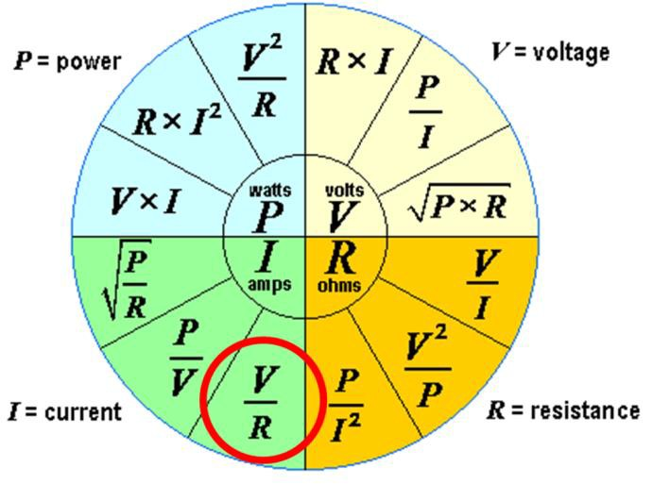
The 35 Most Missed & Misunderstood
Electrical Inspection Items
Let’s go to Ohms Law
Current = Voltage / Resistance
I = V / R
Voltage = 120v Resistance is a value of .6

Slide 102
The 35 Most Missed & Misunderstood
Electrical Inspection Items
Let’s go to Ohms Law
Current = Voltage / Resistance
I = V / R
Voltage = 120v and Resistance is a value of .6 120 / .6 = 200

Slide 103
The 35 Most Missed & Misunderstood
Electrical Inspection Items
Let’s go to Ohms Law
Current = Voltage / Resistance
I = V / R
Voltage = 120v and Resistance is a value of .6 120 / .6 = 200
Resistance increases to 5
120 / 5 = 24 See the drop in current!

Slide 104
The 35 Most Missed & Misunderstood
Electrical Inspection Items
So, what does this mean?
Half of the home will have a drop in watts incandescent lights will be dimming.
The other half will show a huge increase ½ the incandescent lights will be very bright and burning out.
SO ???

Slide 105
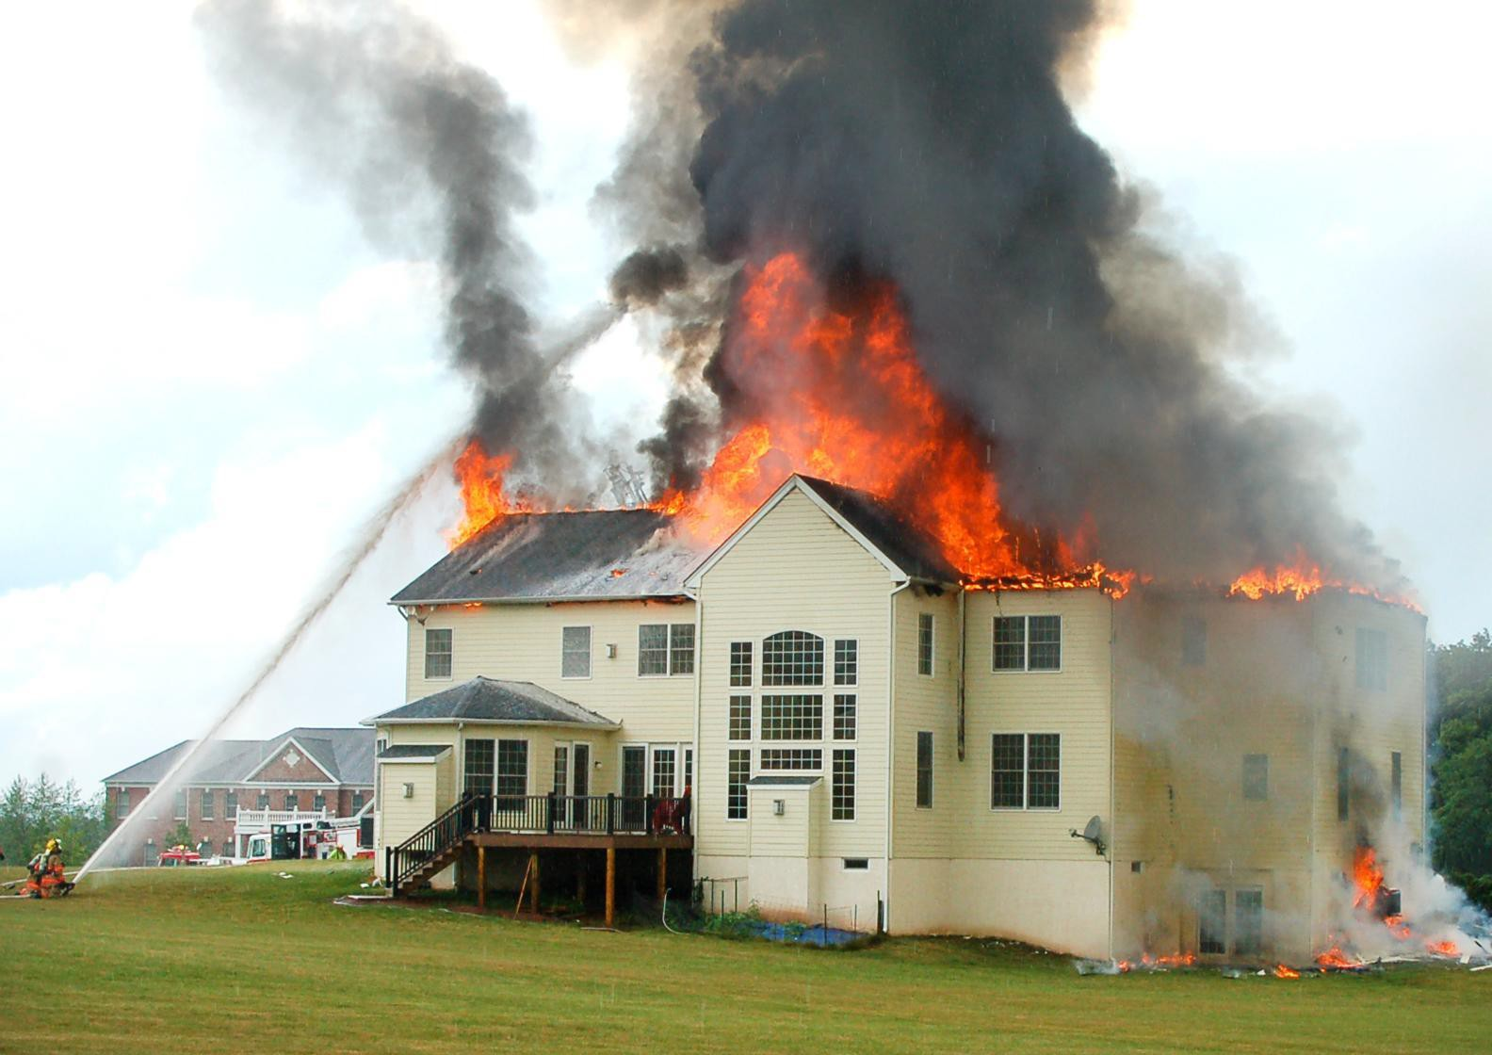
The 35 Most Missed & Misunderstood
Electrical Inspection Items
IT CAN CAUSE A HOUSE FIRE!

Slide 106
What is Stray Voltage?

Slide 107
Why do we have Stray Voltage?

Slide 108
Where does Stray Voltage come from?
How and where do I measure stray voltage?
Does Grounding/Bonding take Stray Voltage to zero volts?

Slide 109
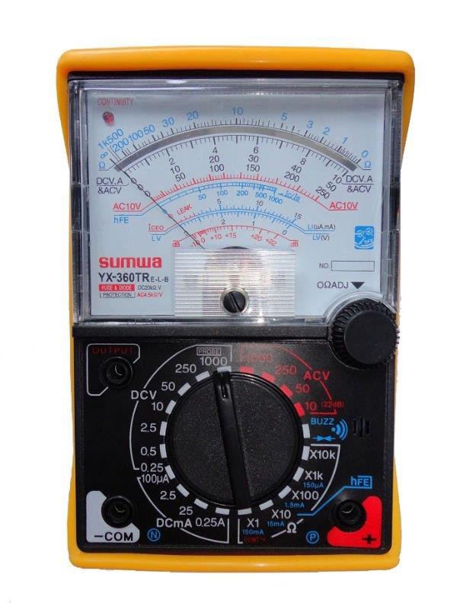
The 35 Most Missed & Misunderstood
Electrical Inspection Items
Would you be surprised to learn if you take a voltage meter (analog) and connect one lead to your gas meter and the other to earth, or your water pipe to earth, or even your swimming pool ladder to earth you will get a voltage reading. This is stray voltage.

Slide 110
The 35 Most Missed & Misunderstood
Electrical Inspection Items
I can remember being in the 7th trade making a Crystal Radio to listen to the World Series. I hid the radio components in a hole cut out of the center of an old book. The antenna was a wire dropped at lunch from a second floor classroom window. I sat near the window and I could alligator clip on the radiator to ground and get the stray current to powered the radio.

Slide 111
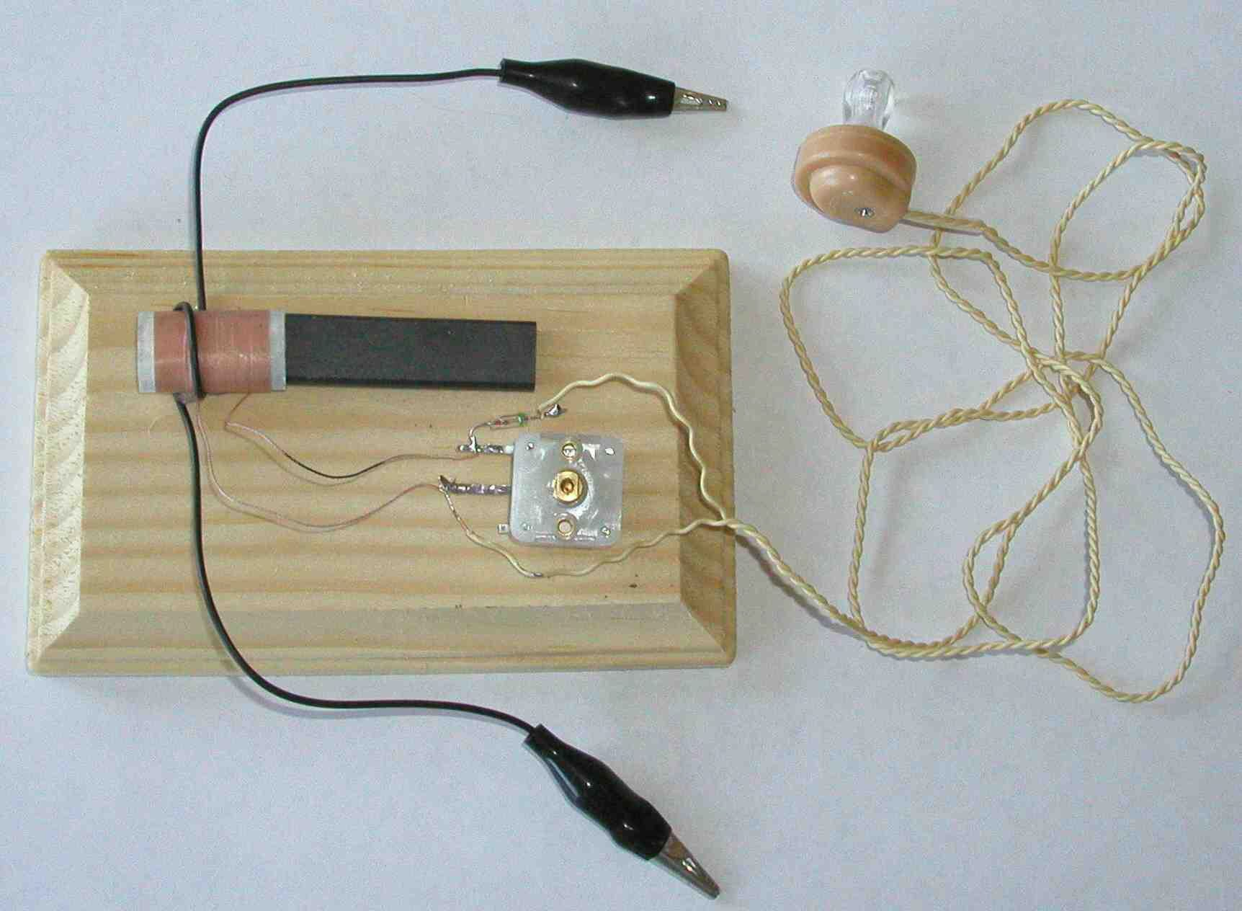
The 35 Most Missed & Misunderstood
Electrical Inspection Items

Slide 112
What is Stray Voltage?
Why do we have Stray Voltage?
Where does Stray Voltage come from?

Slide 113
The 35 Most Missed & Misunderstood
Electrical Inspection Items
What is Stray Voltage?
Stray voltage is the occurrence of electrical potential between two objects that ideally should not have any voltage difference between them. Small voltages often exist between two objects in separate locations, due to normal current flow in the power system

Slide 114
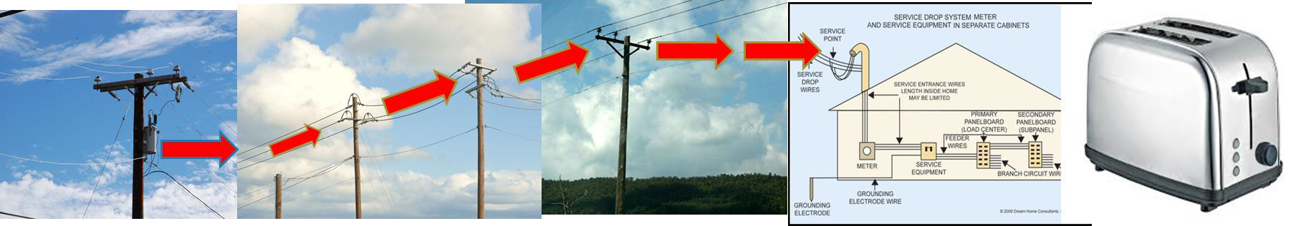
The 35 Most Missed & Misunderstood
Electrical Inspection Items
Why do we have Stray Voltage?
Where does Stray Voltage come from?
Let’s go back to our trusty toaster example. We all understand there is resistance in the wires. Based on distance and the size of the wire (AWG) and distance, there will be a voltage drop. The amount of voltage drop from the transformer to your home will show up as stray voltage.

Slide 115
Stray Electric… Big Deal!
Why should I care?

Slide 116
You are responsible, during your inspections, to insure the electrical system is properly grounded and bonded.

Slide 117
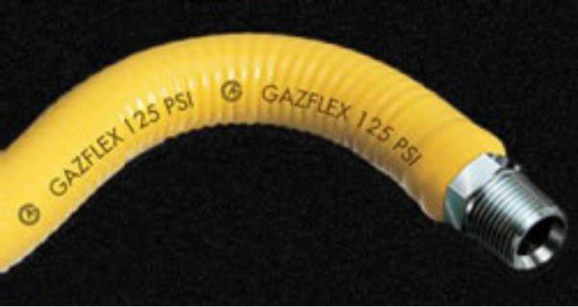
The 35 Most Missed & Misunderstood
Electrical Inspection Items
One reason is if water lines are not properly bonded you may feel stray current (shock) getting into the bath or swimming pool.
If your gas lines are not bonded, especially CSST, you could end up with ……

Slide 118
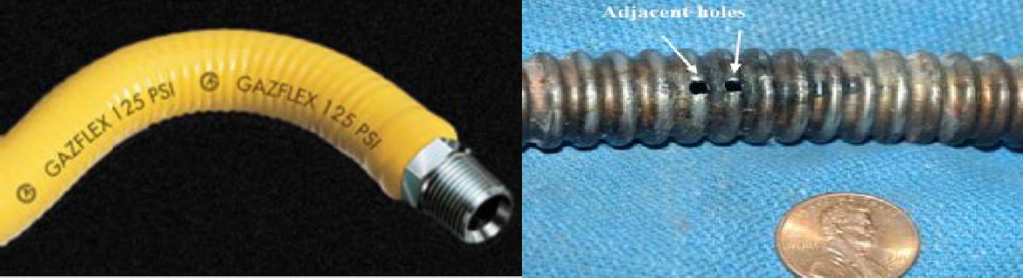
The 35 Most Missed & Misunderstood
Electrical Inspection Items
One reason is if water lines are not properly bonded you may feel stray current getting into the bath or swimming pool.
If your gas lines are not bonded, especially CSST, you could end up with ……

Slide 119
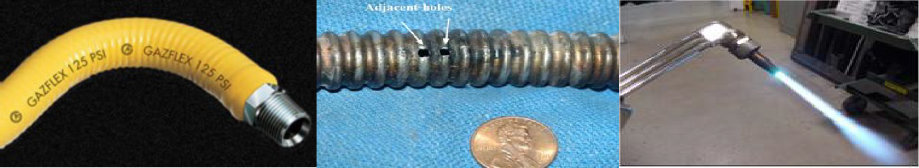
The 35 Most Missed & Misunderstood
Electrical Inspection Items
One reason is if water lines are not properly bonded you may feel stray current getting into the bath or swimming pool.
If your gas lines are not bonded, especially CSST, you could end up with ……

Slide 120
The 35 Most Missed & Misunderstood
Electrical Inspection Items
WITH A HOUSE FIRE!

Slide 121
The 35 Most Missed & Misunderstood
Electrical Inspection Items
Who can tell me what the difference is between grounding and bonding?
Show of hands

Slide 122
The 35 Most Missed & Misunderstood
Electrical Inspection Items
For premises' systems that operate under 600V, grounding “Does Not":
Assist in clearing a line-to-case fault because of its high resistance (IEEE 142 - 2.1.4 and 4.1.1)
Establish a "zero system reference"
Reduce shock hazard to a safe value (IEEE 142 - 2.2.8)
Grounding does provide a path to the earth for:
  Lightning
  Static electricity
  High-frequency noise

Slide 123
The 35 Most Missed & Misunderstood
Electrical Inspection Items
Bonding Summary
For premises' systems that operate under 600V, bonding the system to metal parts does:
  Stabilize the system voltage to referenced metal parts [IEEE 142 - 1.5.2.]
  Assist in clearing a line-to-case fault [250.4(A)(3), (4) and (5)]
  Establish a "zero system reference" (IEEE 142 - 2.2.8)

Slide 124
The 35 Most Missed & Misunderstood
Electrical Inspection Items
Who can NOW tell me what the difference is between grounding and bonding?
One of the thing that make this tough is the NEC National Electrical Code itself. The NEC many times uses “grounding” when it really means “bonding”

Slide 125
The 35 Most Missed & Misunderstood
Electrical Inspection Items
When you write your reports, you want to be consistent. Grounding is a wire with the conductors providing an alternative electric path to the earth in an electrical system.

Slide 126
The 35 Most Missed & Misunderstood
Electrical Inspection Items
Bonding is a wire to non normally electric conductors to provide a path to the earth. Example metal water pipes, gas pipes, furnace air ducts, metal buildings, electric panel cabinets.

Slide 127
How many of you feel comfortable when you walk up to the electric panel for an inspection?

Slide 128
The 35 Most Missed & Misunderstood
Electrical Inspection Items
Your Safety Comes first!
The first thing should do is lightly touch the front of the panel with the back of your hand to ensure the electric panel is not energized.
If you feel that tell-tell electric tingle STOP!
Call in a Qualified Licensed Electrician

Slide 129
The 35 Most Missed & Misunderstood
Electrical Inspection Items
Where is the main panel located?
Show of hands
Outdoors or Indoors ?

Slide 130
The 35 Most Missed & Misunderstood
Electrical Inspection Items
Where is the main panel located?
Show of hands
Outdoors or Indoors ?
Congratulations! You are 100% correct!

Slide 131
The 35 Most Missed & Misunderstood
Electrical Inspection Items
Where is the main panel located?
Show of hands
Outdoors or Indoors ?
The Location does not matter, but it does…..
The location must be a dedicated location with adequate workspace

Slide 132
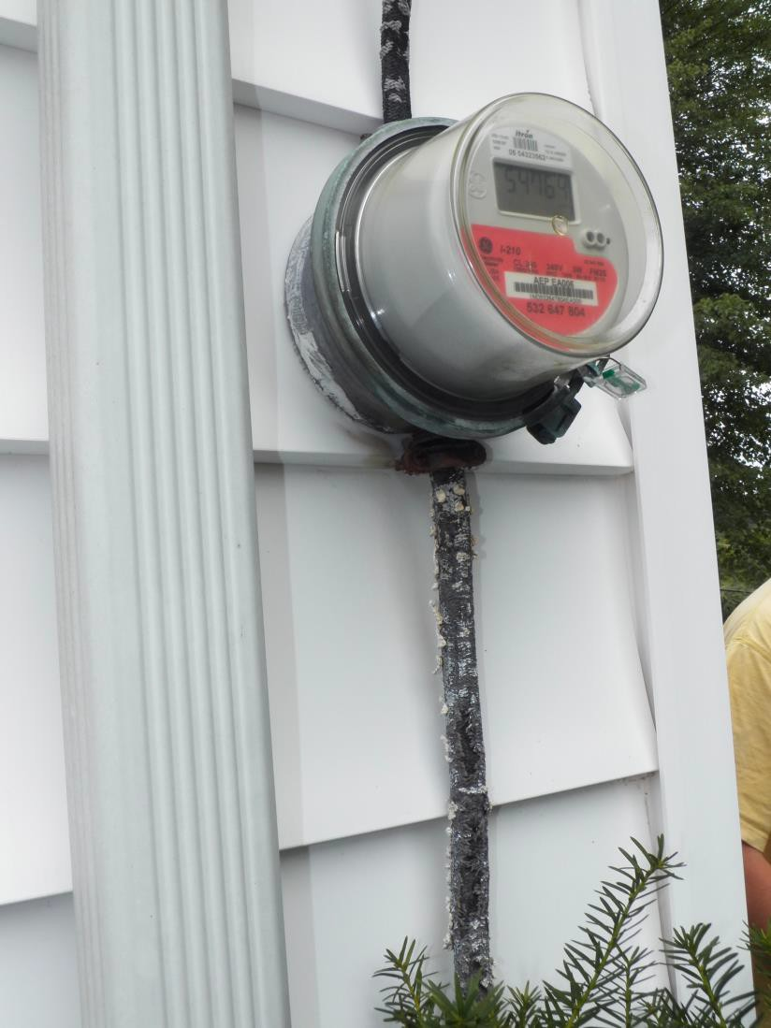
The 35 Most Missed & Misunderstood
Electrical Inspection Items

Slide 133
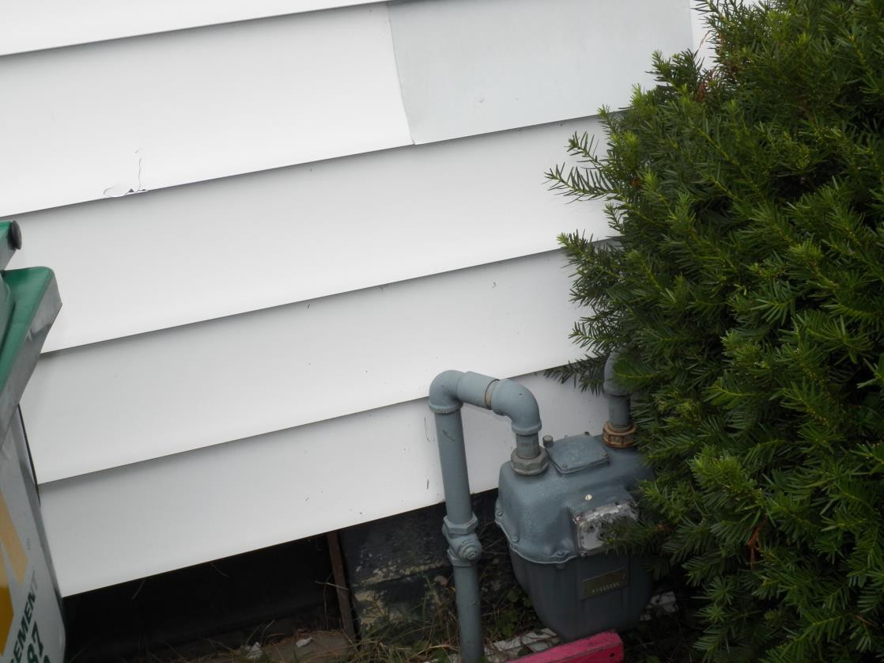
The 35 Most Missed & Misunderstood
Electrical Inspection Items

Slide 134

The 35 Most Missed & Misunderstood
Electrical Inspection Items

Slide 135
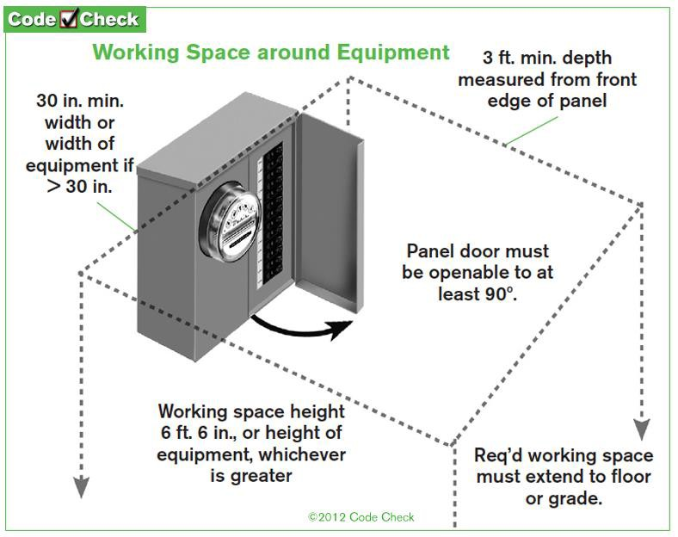
The 35 Most Missed & Misunderstood
Electrical Inspection Items

Slide 136
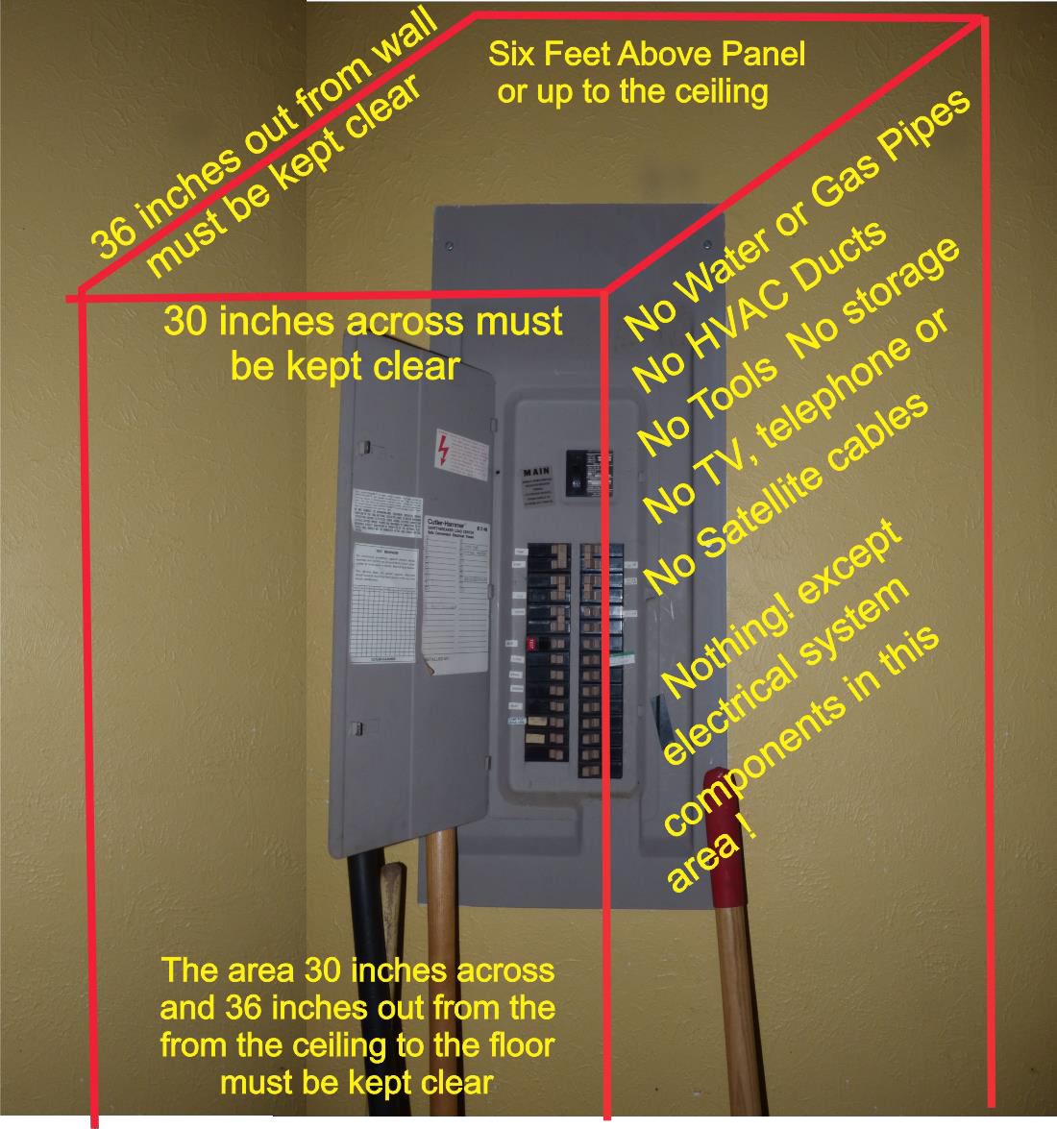
The 35 Most Missed & Misunderstood
Electrical Inspection Items

Slide 137
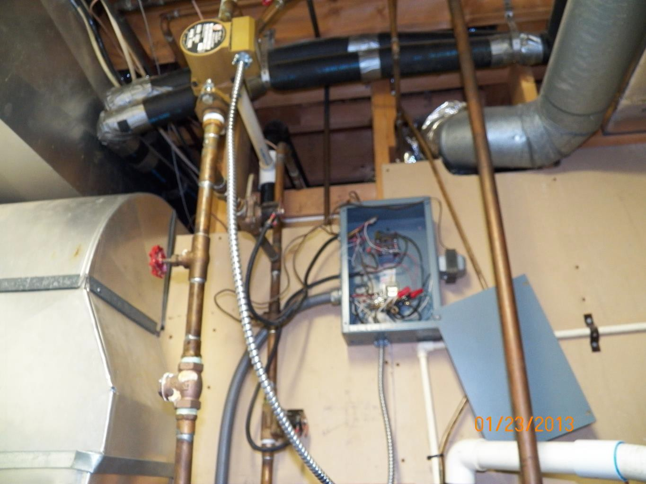
The 35 Most Missed & Misunderstood
Electrical Inspection Items

Slide 138
The 35 Most Missed & Misunderstood
Electrical Inspection Items
What is the difference between a MAIN electrical
Panel and a SUB Panel?

Slide 139
The 35 Most Missed & Misunderstood
Electrical Inspection Items
What is the difference between a MAIN electrical
Panel and a SUB Panel?
The Main Panel is the first panel from the service drop.

Slide 140
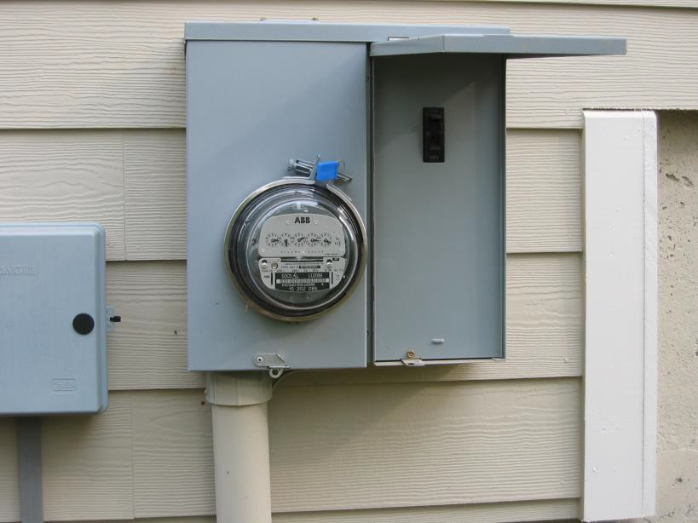
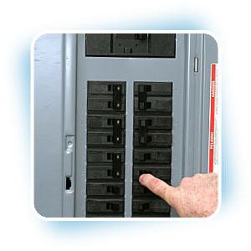
The 35 Most Missed & Misunderstood
Electrical Inspection Items
The main panel can be outside at the disconnect or immediately inside.

Slide 141
Thank you!

